Slide 1
From Accelerated Cyber to an AI Framework

Slide 2
AGENDA
Cybersecurity is a Data Problem Cybersecurity challenges are complex and data are vast
History of GPU Accelerated Cybersecurity Morpheus is the result of a body of work performed by NVIDIA cybersecurity engineering and research
Deploying Cyber AI with Morpheus Introduce Morpheus and its ability to convert the network fabric into a distributed network of sensors

Slide 3
Cybersecurity a data problem

Slide 4




Cybersecurity is a data problem
Requires Visibility into Every User & App in the Data Center
HIGH VELOCITY DATA STREAMS
HETEROGENEOUS Data
Cross environment INTEGRATIONS
QUICK ITERATIONS & pivoting
Traditional methods & tools are not fast enough and rely too heavily on heuristics
228 days
to identify a breach
$8.64M
average cost per breach
Notes:
At its core, cybersecurity is a data problem. And it’s a fundamental belief of Morpheus that modern cybersecurity challenges benefit from an approach rooted in first principles. High velocity streams of heterogeneous data can easily overwhelm traditional collection mechanisms – to the point where most enterprises have to limit the amount of data they capture and analyze. How are we expected to defend against attacks with critical data missing?
Analysts often want to integrate tools and data to provide an enriched picture of what’s happening in and around the network. While this is possible today, it’s frequently done manually – perhaps at the SIEM level. Deeper integrations, especially those that necessitate a decentralized approach, are difficult to engineer and frequently result in “one off” architectures.
Being able to quickly triage and iterate on a perceived threat is a crucial component of security analysts. Contextualizing results or even raw data from one source to another is often done by a human. And while it’s good to provide tools and capabilities that accelerate the human portion, offloading some of this to an AI is where we must go - reducing the cognitive load on an already strained workforce
The way we’ve approached this as an industry in the past will not continue to work. Heuristics aren’t enough to stop and identify breaches and protect enterprises from the high cost (in terms of both monetary and reputation loss) of a breach.

Slide 5




Cybersecurity presents unique challenges
Current Methods Cannot Scale
SHORTAGE OF PROFESSIONALS
Worldwide shortage of over 2.93M cybersecurity professionals, and 53% of companies report a problematic shortage.
DIFFICULT DEPLOYMENTS
Managing large-scale, heterogenous deployments for cybersecurity is challenging. Providing compute at the edge, gateway, and central nodes that can be used holistically requires specialized engineering knowledge.
LOG COLLECTION OUTPACING ANALYSIS
The amount and quantity of logs collected on, and devices added to networks continues to increase.
MODEL COMPLEXITY
More complex models gives you additional inference capabilities, but they are difficult to scale and deploy in real-time environments.
Notes:
New methodologies, frameworks, platforms, and mindsets are necessary to move the industry forward.
There persists a global staffing shortage. But even if there wasn’t, there is too much data and analysis necessary. Investigation and remediation is becoming more sophisticated and specialized, compounding the issue. The number of breaches worldwide continues to increase, and as an industry, we can’t collect all the data necessary in every scenario. It’s simply too large.
We’ve already mentioned deployment difficulties, and they get even more complex when you need to orchestrate data and models across your entire network – edge, gateway, and central. This requires specific engineering knowledge and expertise, of which some companies may not have to resources to supply.
And speaking of models, we continue to use more and more complex models in production deployments. Just look at the emerging trend of viewing cybersecurity as a natural language problem. But how do you get these more complex models into a production environment and keep them updated?
We at NVIDIA have expertise in these hard engineering challenges. Along with our cybersecurity partners, we believe the Morpheus framework addresses these challenges for both today and tomorrow.

Slide 6
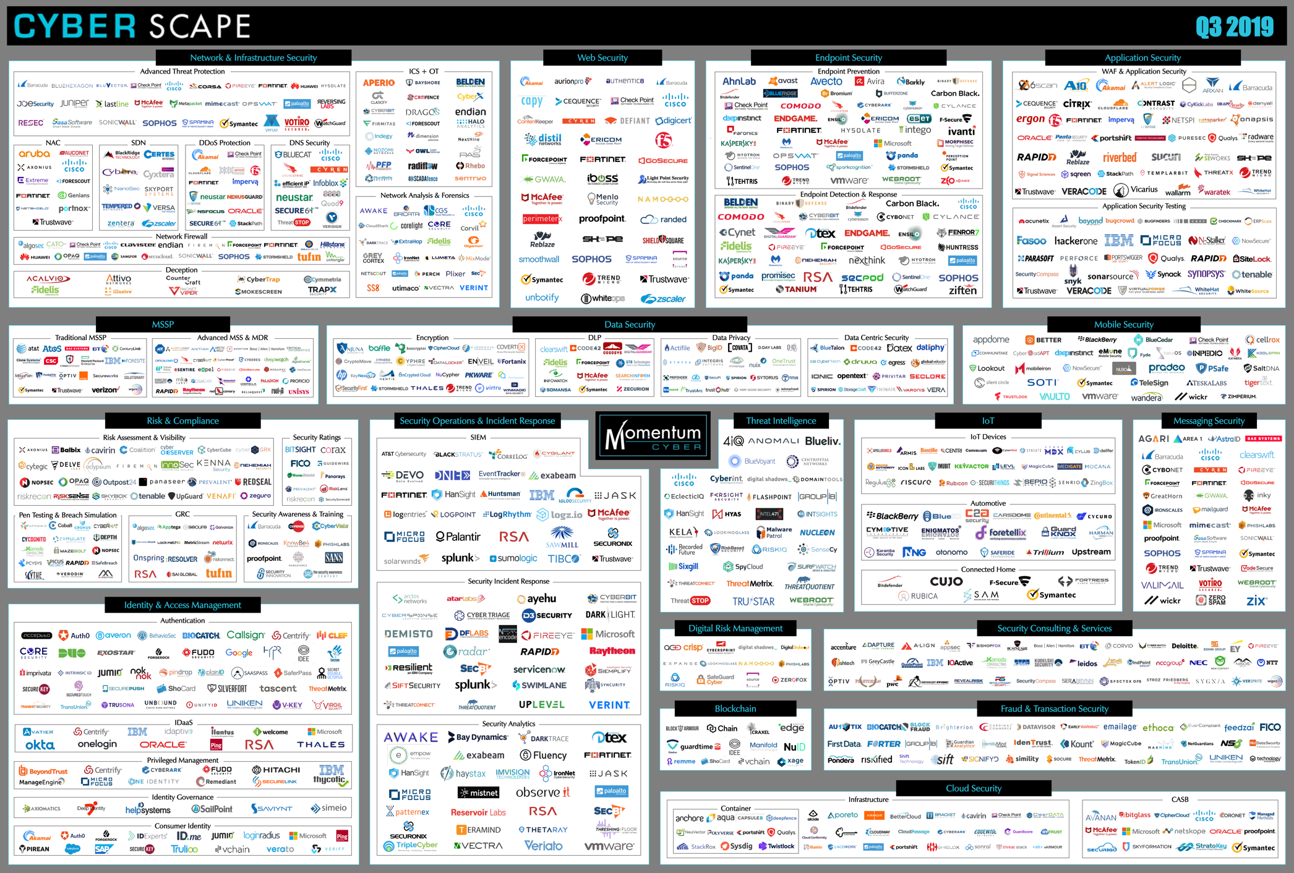
Source: Momentum, https://momentumcyber.com/docs/CYBERscape.pdf

Slide 7
History GPU accelerated cyber

Slide 8
Day in the life
Good Data Science starts with a question or mission objective
Develop Capability
Deploy with Morpheus
Build a problem taxonomy for the business question
Exploratory, Predictive?
Unsupervised, Supervised Learning?
Determine the ML Algorithms to be used for training
Feature Engineering
Validate the results and determine the platform to execute models and algorithms
Comprise many iterative cycles
Running the ML routine
Visualizing, tuning, and refining the output
Inputting the results back into the system
Identify where the data exists
Databases, Data Warehouses, Data Lakes?
Structured, Unstructured?
ETL
Identify how to prepare data for ML execution
Explore the data to get familiarized
Transformation, normalization, cleansing?
Selection of training sets for Supervised Learning?

Slide 9

A new computing thesis
Making it easier for developers and data scientist to maximize algorithm performance
TRADITIONAL MODEL
RAPIDS MODEL
APP B
APP B
Read Data
Read Data
APP B
APP B
APP A
APP A
GPU data
GPU data
APP B
Copy & Convert
GPU w/ RAPIDS
CPU
Copy & Convert
GPU
Few or No Copies to CPU
GPU data
GPU data
APP A
Copy & Convert
Load Data
APP A
Load Data
APP A
CPU
NVIDIA GPUs can be used to accelerate MUCH more than Deep Learning training and inference. GPUs are perfect for ETL, (classical) Machine Learning and data visualization. RAPIDS future extends General Purpose GPUs through CUDA-X, allowing developers to do away with CPU and I/O inefficiencies for computationally intensive tasks!

Slide 10
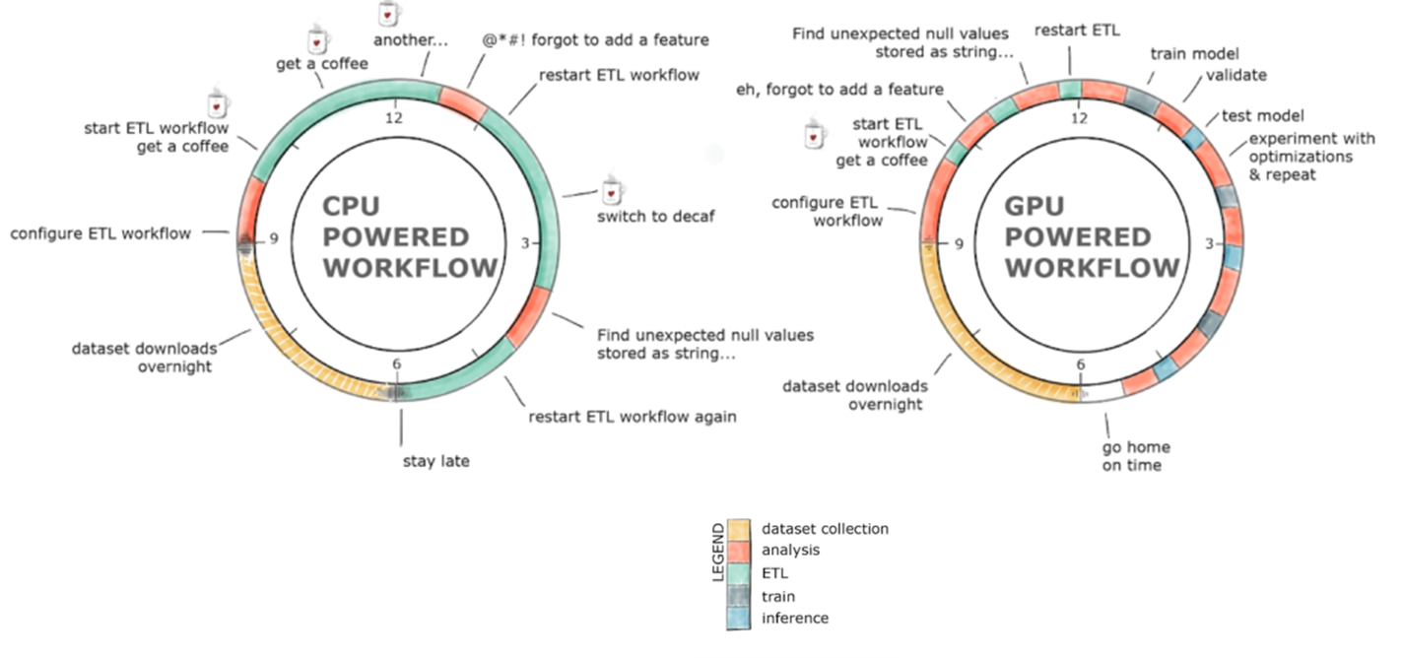
Lots to do with little time!
With the right tools, ETL does not have to take forever

Slide 11
How can we leverage the expertise of data scientists and fast GPU compute while maintaining interoperability with current SOC tools and platforms?

Slide 12


Clx components
Notebook Examples, SIEM Integrations, Workflows, Primitives
Notebooks geared towards InfoSec and cybersecurity data scientists and data engineers
Network use case
Log parsing
SIEM integrations that enable easy data import/export and data access
Splunk integration
Direct query
Workflow and I/O components that enable users to instantiate new use cases
Cyber-specific primitives that provide accelerated functions across cyber datatypes

Slide 13
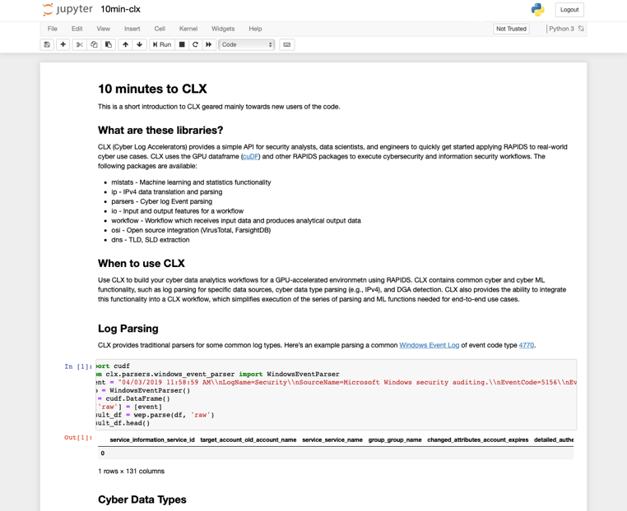
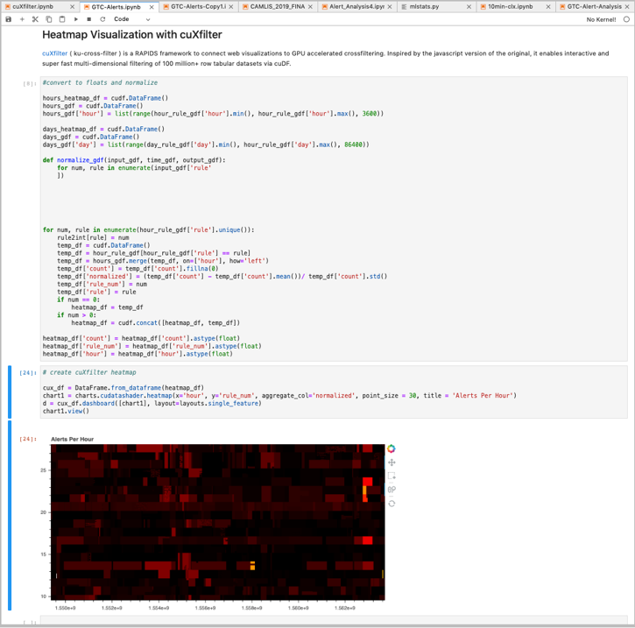
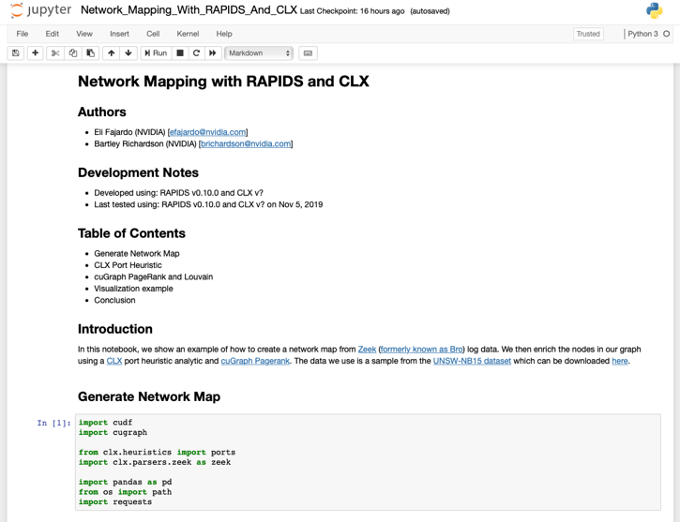
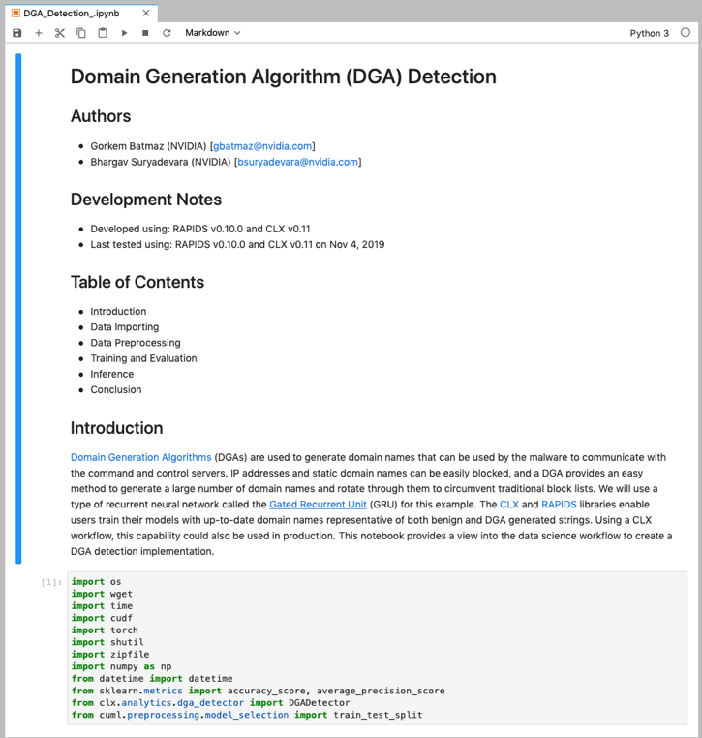
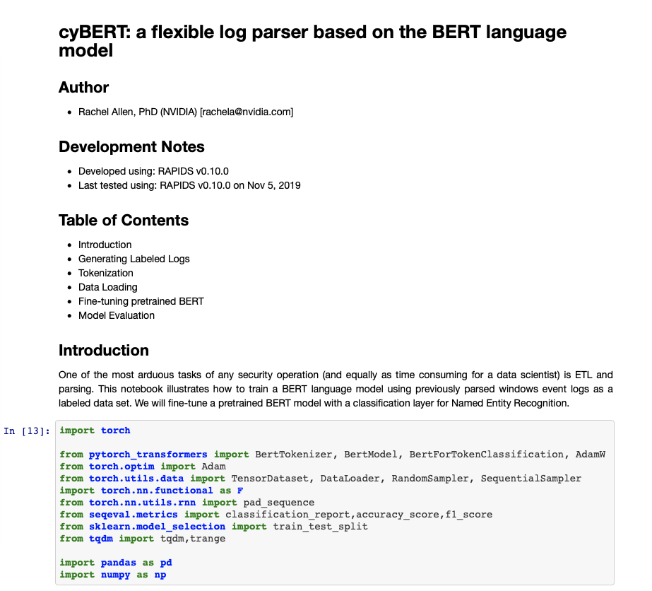
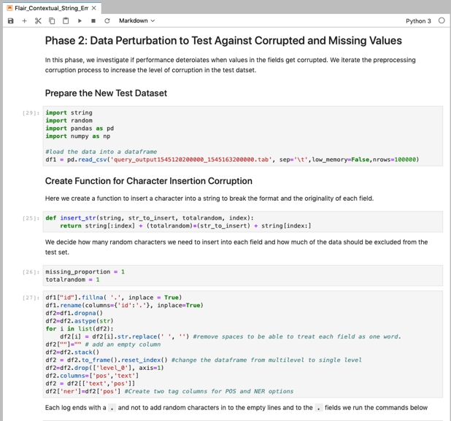
EXAMPLE NOTEBOOKS

Slide 14
Deploying Cyber AI with Morpheus

Slide 15
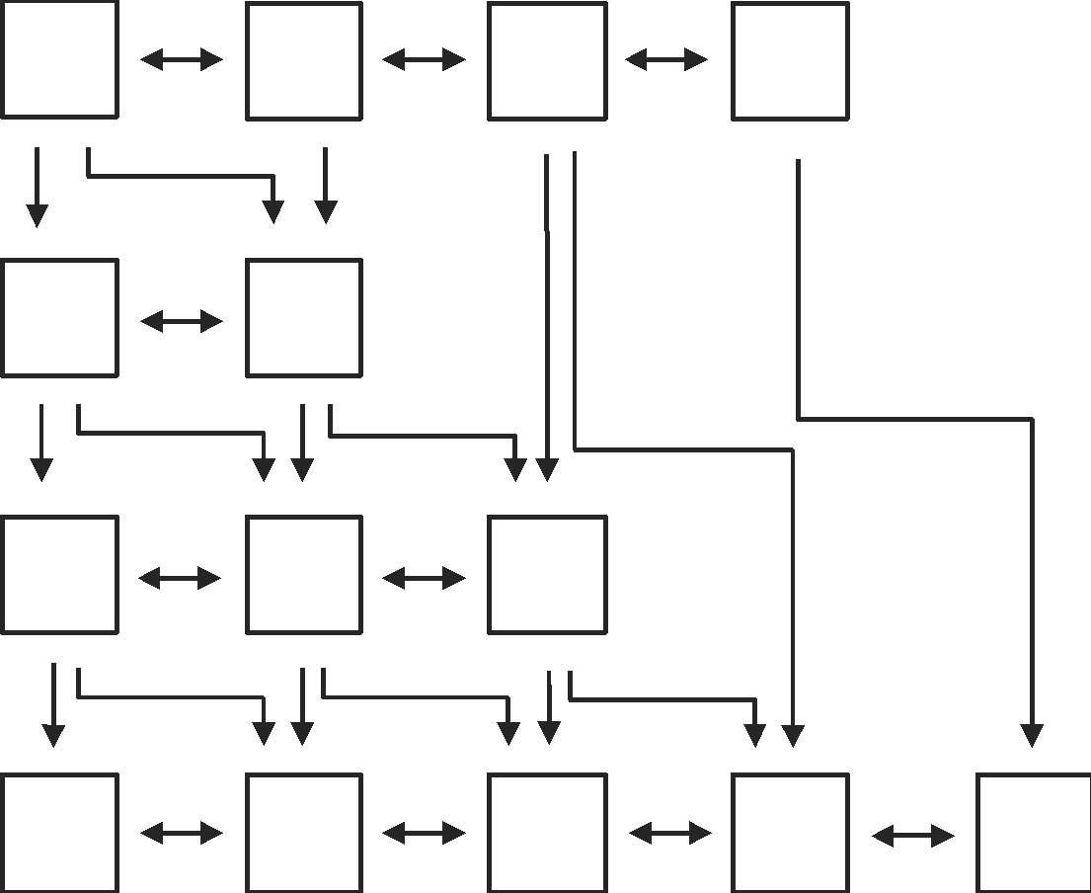
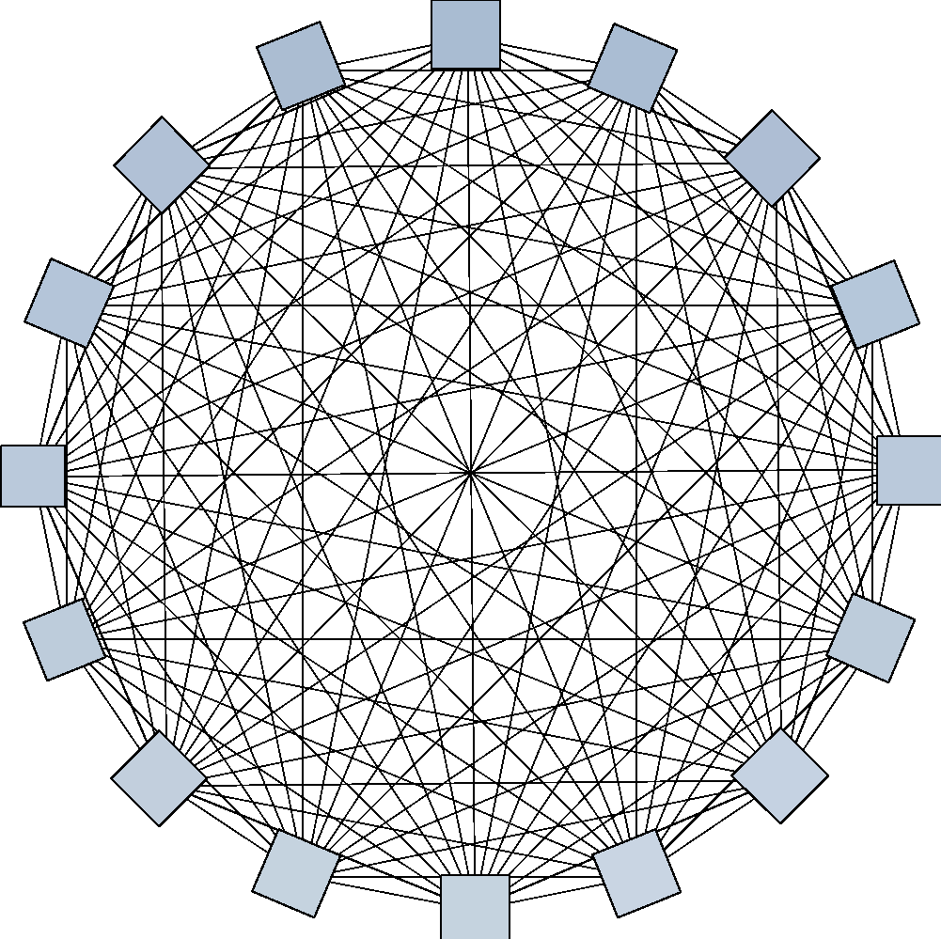

THE MODERN DATA CENTER HAS NO BOUNDARIES
MICROSERVICES
EAST-WEST TRAFFIC
ZERO TRUST SECURITY
Notes:
With containers and microservices, 85% of traffic is now East West.
It’s not good enough to just secure your perimeter since security is now distributed.
In fact, 50% of attacks that have happened are from insiders. The intruder is already inside and protecting each compute node is more critical than ever.

Slide 16


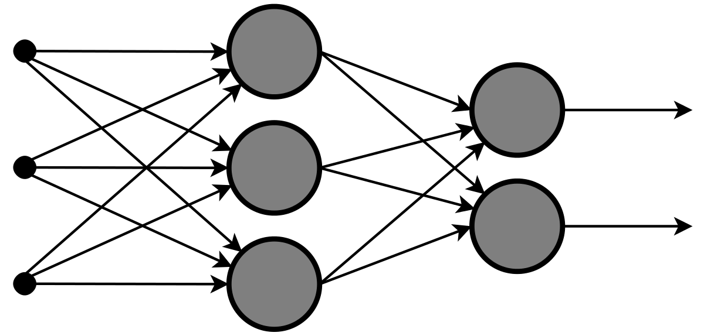
FLOW OF AN AI ENGINE
PERCEIVE
INFER
ACT
Notes:
We’ll be using this general three-step process as our reference as we walk through Morpheus – perceive, infer, and act.
Much like we saw with smart cities, perception requires a collection of sensors, inference is computation-heavy, and an action is completed after a result is given from inferencing

Slide 17
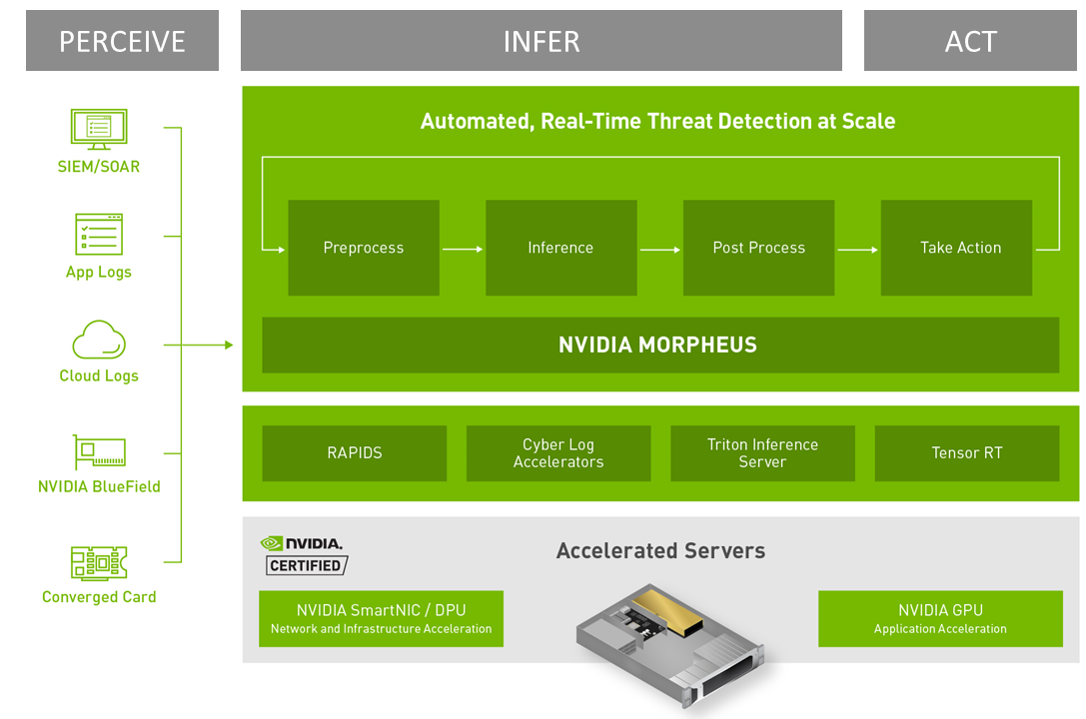
Nvidia Morpheus cybersecurity ai framework
Morpheus is the framework that makes AI a viable cybersecurity asset
Develop and deploy novel capabilities that change the game for cyber defense
Notes:
Invent IP & offer differentiated services that change the game for customers
Develop and deploy novel capabilities that change the game for cyber defense

Slide 18
Cybersecurity sessions at GTC
Be sure to check out the many cybersecurity-related sessions at GTC
Search GTC sessions for “Morpheus”
The Edge Meets Massive Compute: Leveraging DOCA and Morpheus for a Complete End-to-end Detection and Mitigation Pipeline [S41728]
Build AI-Enhanced, Next-Generation Cybersecurity Solutions with NVIDIA Morpheus
Copilot for Splunk: Using Massive Language Models for Query Generation on Morpheus
Transform Cybersecurity with Accelerated Data Science
Cybersecurity: Real-time AI-enabled SOAR for Edge Networks
Leveraging AI to Modernize Cybersecurity
And many more

Slide 19
MORPHEUS PIPELINE
New pipeline engineered specifically for cybersecurity needs
High performance throughput is required, with the ability to achieve at least 10Gb/s throughput on single GPU deployments
Implements async computation and mitigation of I/O and GPU blocking via Boost fibers
Backpressure support implemented with concurrent blocking queues between stages
Support for distributed computation, which is required for larger pipelines with higher data volumes and velocities, via message transfers over RDMA using UCX
Support for dynamic reconfiguration that allows scale up and scale out at runtime via a centralized orchestration service
Organized into multiple layers: operator, node, segment, and orchestration
Notes:
The new pipeline in Morpheus was specifically designed and engineered to support the massive and complex workloads that cybersecurity ISVs and practitioners demand.
First and foremost, it has high performance throughput – capable of reaching at least 10 Gb/s end-to-end on a single GPU (for example, a Titan RTX or an A100).
It implements asynchronous computation and mitigates I/O and GPU blocking by utilizing a fiber-based (local threading) programming approach. No more GIL!
Since the volume of security feeds is somewhat unreliable, backpressure support is implemented throughout, with concurrent blocking queues between stages. We also support distributed computation, and not just any form of distributed computation. Morpheus now uses RDMA with UCX to transfer messages extremely quickly and efficiently.
But we didn’t stop there. Morpheus also, for the first time, supports dynamic reconfiguration that allows seamless scale up and scale out changes at runtime, all handled under-the-hood by a centralized orchestration service.
I know, it sounds complex – and there’s some truth to that. But it’s also organized in an extremely efficient and approachable fashion, with multiple layers including operators, nodes, and segments.

Slide 20
Morpheus Pipeline
Organized into four levels with responsibilities distributed throughout the levels
Orchestration Level
Single service that manages and connect pipelines. Channels use orchestration to discover and connect multiple pipelines together. Can start/stop pipelines dynamically. Multiple instances of a segment can be distributed.
Segment Level
Segments are composed of one or more nodes. Data flows between segments via channels, and channels can connect segments in 1:1, 1:M, or M:N architectures. Channels can be reconfigured at runtime to add/remove connections dynamically.
Node Level
Nodes contain operator chains that are executed for every object pulled off input queue. Data flows via fiber-aware blocking concurrent queues. Nodes may run multiple instances of operator chain simultaneously in separate fibers.
Operator Level
Lowest level, data flows via direct memory passing. Operators are very small, single function objects (e.g., filter, map, reduce). Operators free to mutate. ReactiveX used to implement operators.
Notes:
From the top down, Morpheus is organized into four levels – orchestration, segment, node, and operator. We’re going to go into some technical details here. And if you want to geek out with us on the tech, we’d love it! But also if you just want to use Morpheus, don’t worry – there are Python and C++ APIs that let you take advantage of all of this without having to know the implementation details.
At the orchestration level, there’s a single service that manages and connects pipelines. Channels in Morpheus use this service to discover and connect these pipelines, and multiple instances of a segment can be distributed for fast, parallel computation. We’ll see how segments, nodes, and operators work together in just a bit.
With segments, we start to peel the layers of the onion back. Segments are built from one or more nodes. Data flows between segments via channels, and these channels connect segments in many different configurations: 1:1, 1:M, or even M:M. Connections can be added and removed dynamically at runtime.
The next layer deep is nodes. Nodes contain chains of operators, and these chains are executed for every object (or message) pulled off an input queue. Data in nodes flows via fiber-aware blocking concurrent queues. In other words, there’s no global blocking or locking. And nodes can run multiple instances of an operator chain in parallel, separate fibers.
At the lowest level are operators. Here, data flows via direct memory passing (not copying of the data). Operators are small and single function objects, such as a filter or map operation. We use ReactiveX to implement operators.

Slide 21
MORPHEUS PIPELINE
Multi-level parallelization and encapsulation
Segment 2A
Node 1
Node 2
Thread 1
Thread 2
Thread n
Thread 1
Thread 2
Thread n
•••
•••
Segment 1
Segment 3
Node 1
Node 1
Thread 1
Thread 2
Thread n
Thread 1
Thread 2
Thread n
•••
•••
Segment 2B
Node 1
Node 2
Thread 1
Thread 2
Thread n
Thread 1
Thread 2
Thread n
•••
•••
Notes:
But what does this mean for the overall pipeline? Here we have an abstract representation of a very small example pipeline. Note that segments (green boxes) contain one or more nodes (grey boxes), and the nodes contain chains of operators (blue shapes) running in their own user-space threads (also called fibers).
What’s important to note here is two levels of parallelization. The easiest to see is Segment 2 in the middle. Here we have the same segment being run in two instances across two GPUs or even on the same GPU taking advantage of Multi Instance GPU (or MIG) capabilities. The orchestration in Morpheus takes care of this for you, no need to configure this yourself.
But look a bit closer. Inside the nodes, we observe multiple operator chains. These are running in their own threads, in parallel. So not only are the segments parallelized across GPUs, but the actual threads running inside the nodes are also parallelized. What this means for you, the developer or the user, is that you get extremely fast execution without having to think about the orchestration.

Slide 22
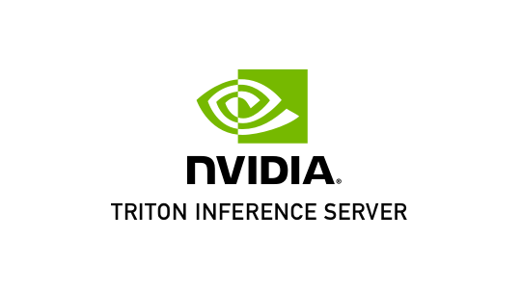

MORPHEUS STRUCTURE
Segments can wrap other technologies, both NVIDIA and non-NVIDIA
Pre-Processing
Inference
Post-Processing
Verify / Action
Segment
Input
Pre-Process
Inference
Post-Processing
Segment
Segment
Notes:
And we mentioned earlier that segments can wrap other pieces of technology – both from us and not from us. On the top, we’re using the Triton Inference Server in the inference stage. To the larger Morpheus pipeline, this looks just like any other segment. Messages are passed the same way, providing a unified programming approach where developers aren’t trying to learn, manage, and integrate many disparate types of technology.
Another example is shown on the bottom, where we use Kafka in a Morpheus segment as an I/O option for a pipeline. The takeaway here is that there’s not a need to manage different interfaces with the new Morpheus pipeline. Once they’re wrapped in segments, Morpheus orchestration handles the rest.

Slide 23
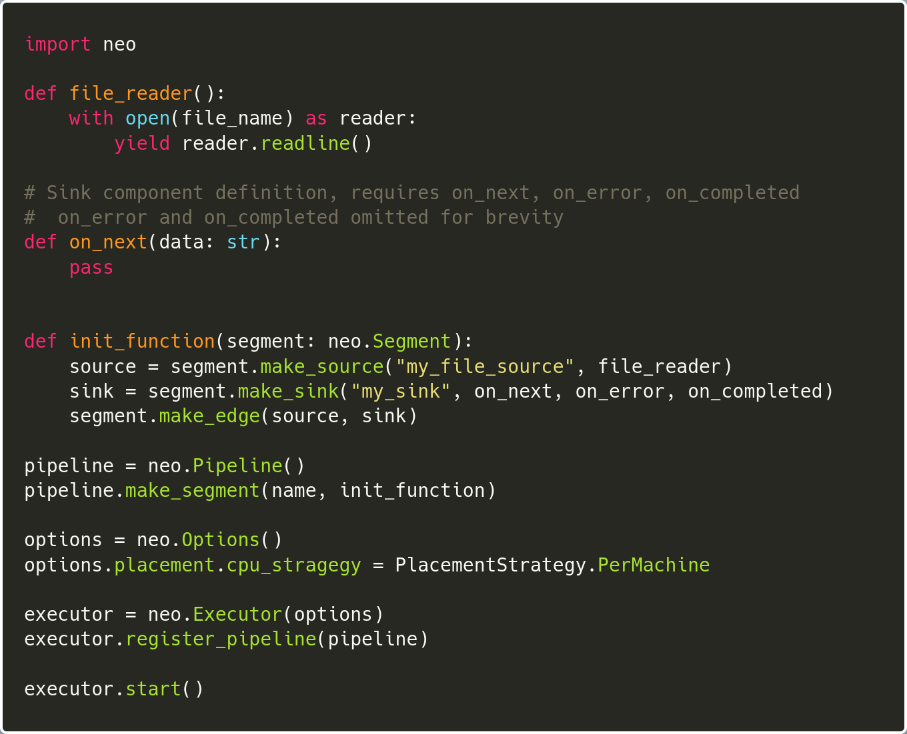
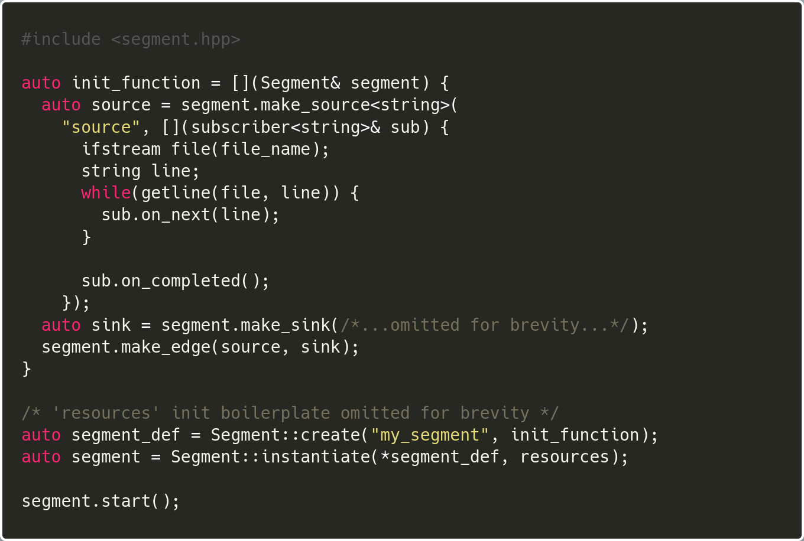
NODE LANGUAge VERSITILITY
Create Morpheus nodes using Python or C++
Nodes with Python
Nodes with C++
Create a File Reader
Create a File Reader
Notes:
Uh oh, code. Full disclosure, there’s more code on the next slide too. So buckle up. But I promise this will be painless (mostly).
With Morpheus, you’re free to write nodes in Python or C++ - we support both. While Python gives you benefits of quickly prototyping a new node or segment, you’ll see maximum speed and throughput developing against the C++ APIs. Both of these blocks of code demonstrate something very simple – creating a file reader. (Remember, many of the frequently used nodes you need already come with Morpheus pre-compiled, including reading from a file.) But just for illustration purposes, we’re using the file reader code here.
In both cases, it’s not a lot of code. And in both cases, it’s fairly straightforward Python or C++. We’ve omitted some of the code on the C++ side for brevity, but you can view the entire source in the latest release of Morpheus.

Slide 24
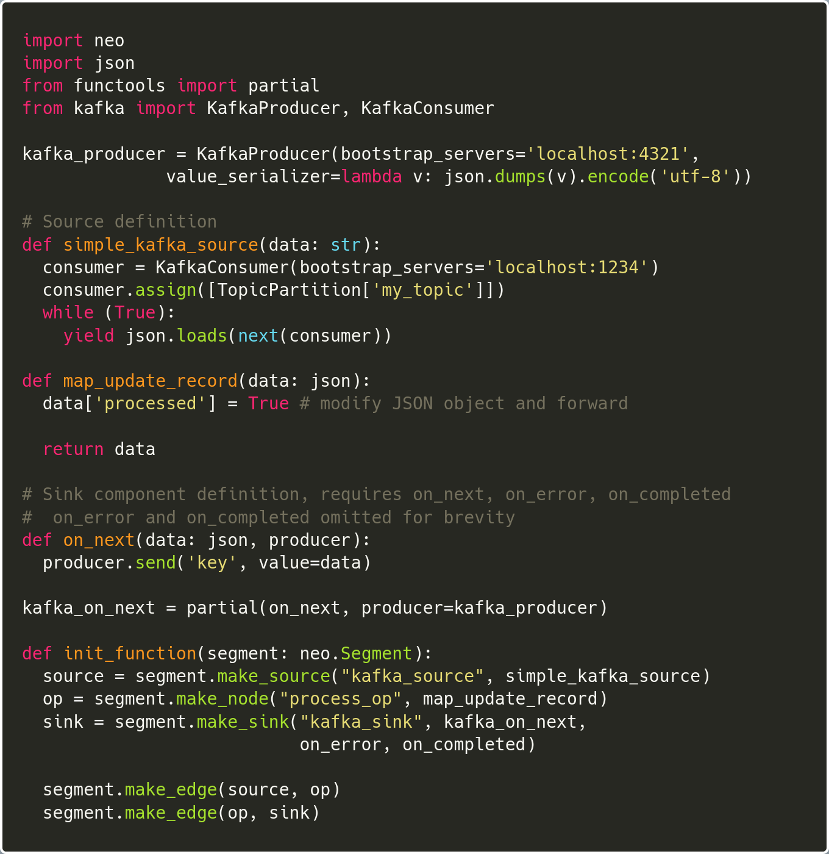
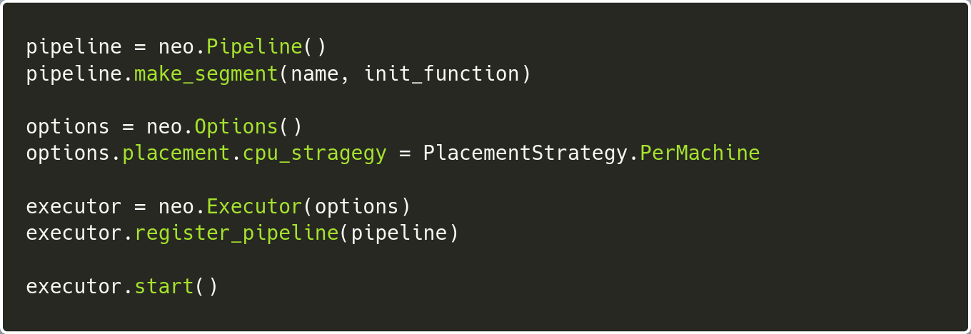
APPROACHABLE PROGRAMMING STYLE
Write programs thinking sequentially but benefit from parallelism
Segment Definition
Segment Launch
Define source node (JSON from Kafka), convert to Python JSON object, forward to an operator node
Operator node modifies record, forwards to Kafka sink
Sink node serialized modified JSON object, writes to Kafka endpoint
Processing flow defined sequentially
Once executor.start() is called, each node runs independently with its own dedicated fiber
Backpressure handled automatically between nodes
Notes:
Here’s that second slide of code I warned you about. But this is the last code slide.
What I think is one of the amazing things about Morpheus EA 2 is the ability to write programs thinking sequentially but then benefit from massive parallelism. Here’s a real simple example.
On the left, we have three nodes being defined: a source node, an operator node, and a sink node. The source node reads JSON data from Kafka and converts it to a Python JSON object. Once forwarded to the operator node, that node modifies the record (in this case, just setting a column value to “true”). The third node is a sink, which serializes the modified Python JSON object and writes it to a different Kafka endpoint. Easy. Three nodes defined – source, operator, destination.
Down at the bottom of the left code block, we now setup the segment. Note how the process is defined sequentially – source, then operation, then sink.
On the right hand side, we see the segment launch code. Once the executor start function is called, each node (remember, we have three of them) runs independently with its own dedicated fiber. One node does not cause any other node to block. If data is coming in too fast to be processed downstream, backpressure kicks in automatically between the nodes. This means that you may have one pipeline that is utilizing backpressure support (and responding correctly), but another pipeline that doesn’t need backpressure will just keep running as usual.
And backpressure isn’t limited to just input and output. It occurs between any node, even collections of operators, leading to an extremely efficient and intelligent pipeline.

Slide 25
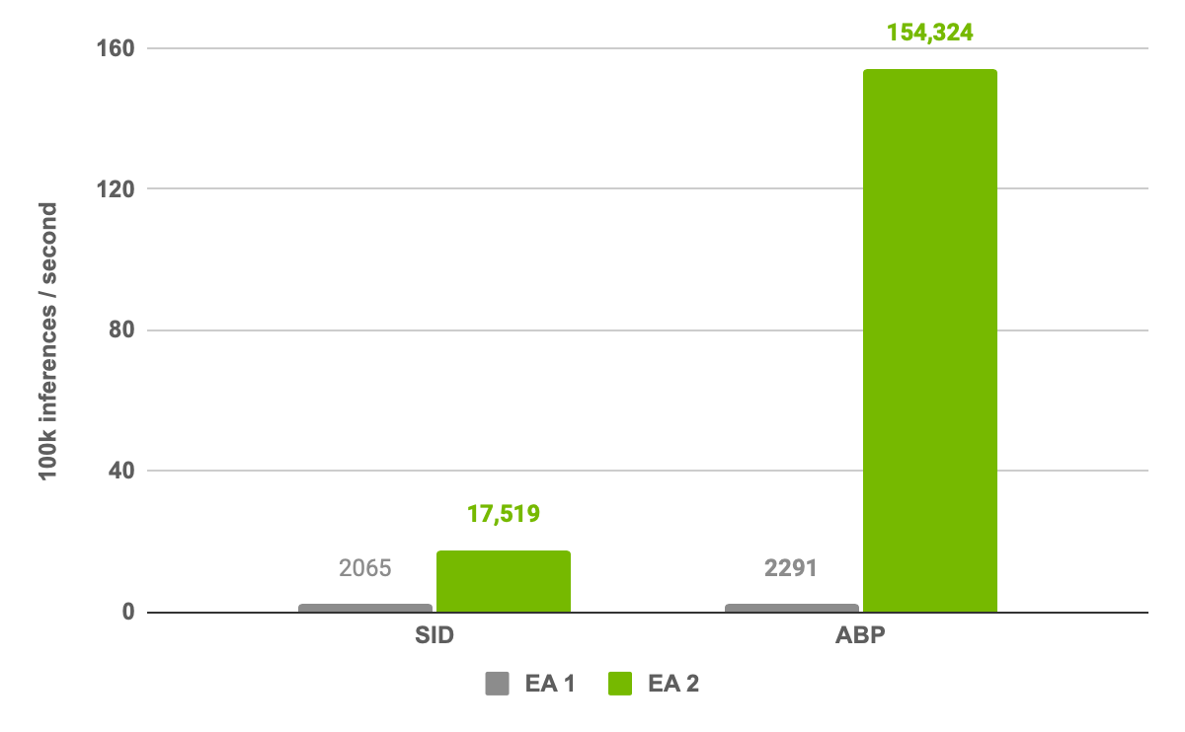
MORPHEUS PIPELINE
Old pipeline vs. new pipeline performance improvements
New Morpheus pipeline and model optimizations have enabled speed ups across the board
SID workflow shows an 8.4x speed increase, while ABP is 67x faster than in the previous version
Even single GPU performance shows a 40x increase in throughput (for ABP models) over the last release
Supports pipelines up to 10 Gb/s (depending on the model used) on single GPU
67x speedup
DGX workstation, 4 A100 (40GB) GPUs
Notes:
And speaking of efficiency and throughput, look at these results. With the new pipeline, we’re seeing speed ups across the board. Our two previous workflows – sensitive information detection and anomalous behavior profiling for cryptomining – both saw significant performance gains. While the former shows a respectable 8.4x bump, the latter is 67x faster than our last release of Morpheus. With over 150,000 inferences per second throughput, this corresponds to over 60 Gbps in a single node, multi-GPU environment. Even single GPU pipelines see speeds of up to 10 Gb/s depending on the model used.
These are impressive, and we still have room to grow. In the future, Morpheus will expand to multi-node environments, with compute further distributed around your data center or hybrid cloud environment. It’s all part of the goal of moving compute closer to the edge and closer to where data is being generated and collected, reducing the need for costly data movement. This also allows us to place intelligent data filtering and collection at the edge, routing higher quality, more actionable data to your analysts when they need it most.

Slide 26
Pre-built Examples

Slide 27
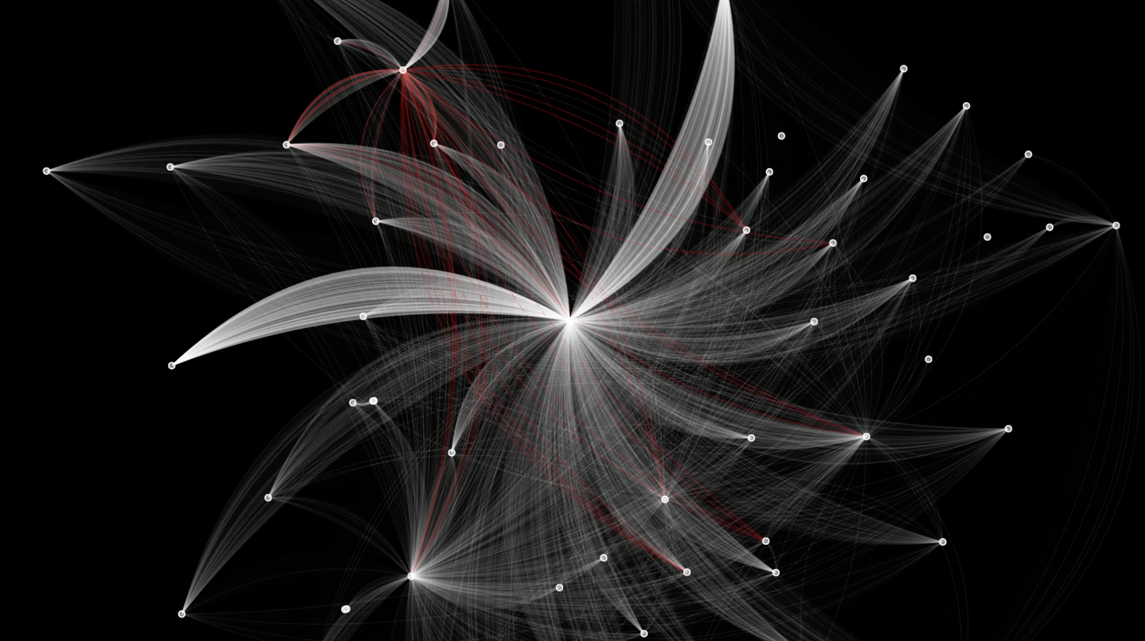

INSTANTLY IDENTIFY LEAKED SENSITIVE INFORMATION
NVIDIA Morpheus examines the raw packet information as it’s generated
NLP model is used to determine if there is sensitive information leaked in the packet
Packets are flagged instantaneously, and a recommended action routed back to BlueField 2
Notes:
If you watched Jensen’s keynote, you likely already saw this demo.
We’ve used Morpheus to deploy a model that examines raw packet (PCAP) data for potential leakage of sensitive information.
The NetQ agent, residing on BlueField 2, is piping raw packets (layer 7 application data) directly to Morpheus.
Inside the framework, we’ve trained and fine-tuned a NLP model to search through the packets and detect any possible leaked credentials (like AWS and GitHub), passwords, private keys, and the like.
Specifically, we’re using a BERT model. An advantage of this approach over a rules-based one or even other ML based approaches is that we don’t need to expose the model to every possible leaked credential during training.
Because the model can generalize, it doesn’t have to be trained exhaustively to flag accurately. We can train the model using examples of AWS credentials but not GitHub credentials. And the model can still alert on both extremely well.
In fact, we’re seeing F1 results over 0.998.
Packets that contain sensitive information are flagged instantaneously, and a recommended action is routed back to NetQ.
Imagine this deployed in a zero-trust environment. While every communication should be encrypted, humans make mistakes. It’s impossible to test every path of a complex software supply chain, especially if it heavily utilizes open-source packages.
With Morpheus deployed in the environment, it doesn’t matter if an app configuration is made that removes encryption or leaks credentials.
You’re alerted real-time, and the keys and credentials impacted are delivered to the operator – speeding remediation by letting you know exactly which pieces of data were compromised.
And I can’t stress this enough, it’s being done completely without rules – using a transformer-based deep neural network.

Slide 28


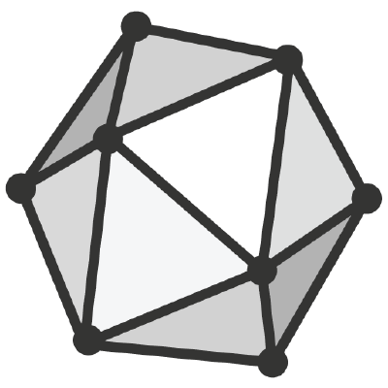



Sensitive info detection Model Fine-Tuning
Utilize transfer learning to quickly adapt a large model to a new environment
Pretrained transformer model from Hugging Face
Pre-Processing
Fine-Tune
Convert
Output
Text Processing
Extract fields
Fine-tuning and hyperparameter optimization for multi-label sequence classification task
Convert fine-tuned model to ONNX
Load model
Subword Tokenize
Word embedding
Split words
Positional encoding
Label 2,Label 4
Label 1
Label 2, Label 6
Labeled training data
Text Data | L1 | L2 | L3
|{"client_id": "50259041", "response_type": "hXJMcWvp", "scope": " | 0 | 0 | 0
{"state": "Massachusetts", "response_mode": "Yvi5VydO | 0 | 1 | 0
{"sort": "coach_form", "order": "agency site", "collectionId": 167091827, | 0 | 1 | 1
Morpheus
BERT-Base
Mini-BERT
Over 11x faster training with Mini-BERT
Only 0.03 decrease in F1
Notes:
Morpheus is designed to accept many different types of models that you might already have. Here’s a bit more information about how we trained our cyBERT model for sensitive information detection.
Like any good NLP application, we start with some labeled training data. If you’re just fine-tuning a pre-trained model, you actually don’t need much of it – maybe as few as 100 examples.
You also don’t need to expose this model to every type of sensitive information you may want to detect. One advantage of using a transformer architecture is that it can effectively generalize, identifying and classifying pieces of data that are similar to ones you’ve trained on.
We then pre-process the data using RAPIDS, which involves extracting salient fields and tokenizing the input. The tokenization makes use of the fast, GPU-native subword tokenizer built into cuDF. By keeping data and operations on the GPU end-to-end, we eliminate unnecessary serializations and deserializations, accelerating the entire workflow.
The fine tuning process is iterative, involving successive runs that adjust the internal weights of the neural network to better match the training data we’re feeding it. You can adjust the number of training epocs used to zero in on an accuracy that works for you.
Specifically for this application, we permutate the data being used for fine-tuning. This means that we don’t just feed in the data as it would appear, but rather we vary the start and end points of pieces of data and artificially tweak the order of how fields appear.
This helps the model learn that order isn’t as important as content. Without this, it would be easy for a model to overfit to positional encoding – even with a small number of training epochs.
After the fine tuning process in PyTorch is complete, we convert that PyTorch model to ONNX. It’s then ready to be loaded directly into Morpheus via MLFlow, the package we use for MLOps.
MLFlow makes it easy to track model deployment. When uploading a newer version of an existing model, the older version is automatically replaced. Inferencing is automatically updated to use the newer model.
Model metrics can also be tracked. In one scenario, you might choose to upload a specific dataset with known inputs and outputs. This is automatically run through a new model, and the output is compared to what it should be. If there are major differences, an alert can be triggered to the operator. This is just another check to ensure a bad model doesn’t make its way into your pipeline.
Fine tuning is extremely fast using a mini-BERT base model. Compared to BERT-base, we see over 11 times faster fine tuning with only a 0.03 decrease in F1 score. Not bad!
While built-in training isn’t a part of Morpheus at launch, we will provide separate training notebooks that show how to fine-tune and prepare models for Morpheus. If you’re already doing model development today, you’re likely familiar with this process already.

Slide 29

Sensitive information detection workflow
Detailed workflow for the sensitive information detection use case and demo
Split Batches
From Kafka
Split Batches
Split Batches
Deserialize
Deserialize
Deserialize
Buffer
Deserialize
Deserialize
Buffer
Deserialize
Probability Filter
Deserialize
Pre-Process
Add Classification
Split Batches
Split Batches
File Input
Regroup
File Output
Input/Processing Container
Triton Inference Server
Triton Container
Notes:
Here we show more detail about the sensitive information detection use case.
NetQ is pushing raw layer 7 data to Morpheus via Kafka. It’s then sent through successive stages through pre-processing, where we tokenize the raw strings using the GPU-accelerated subword tokenizer built into cuDF.
After running through a small buffer, we split the data into batches and send them to a Triton inference server. Triton supports dynamic batching, which is ideal when you may not have consistent data flow volumes.
During inference is where we flag the sensitive information. Essentially we’re performing a named entity recognition task on the data, assigning a label that corresponds to the class, or type, or sensitive information seen.
After inference, we regroup, stitch back together any split tokens and add a probability filter. This filter is configurable, and it’s what we use to adjust the tolerance for false positives versus false negatives.
The recommended action is routed back to NetQ via Kafka.
But we also see here that input and output can just as easily be from and to files. If that’s how you want to configure Morpheus, we support that as well.

Slide 30
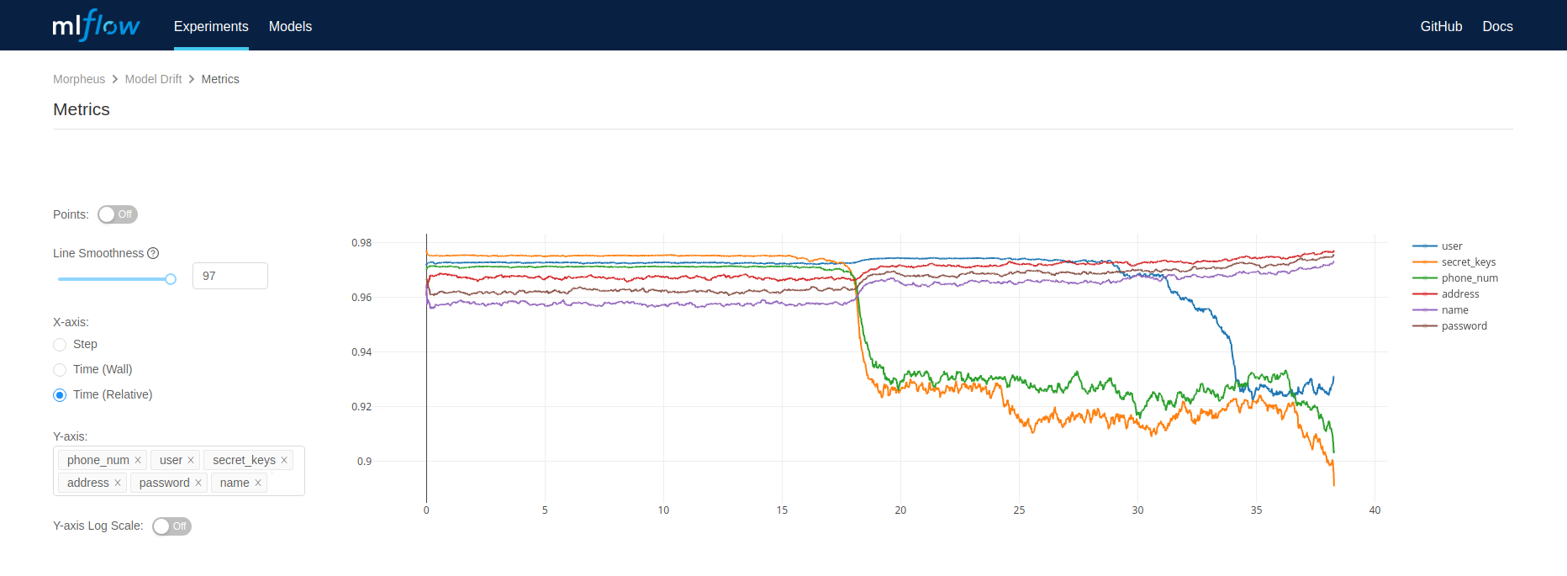
CONCEPT DRIFT MONITORING WITH MLFLOW
Track average confidence score for every label in the Morpheus SID pipeline
Notes:
To aid in the monitoring of model performance on ever evolving datasets, we've added a Morpheus stage that logs metrics to MLFlow for every batch of data run. Concept drift is the phenomenon where the statistical properties of the data change overtime. When this happens, we'd like to know and follow-up with model retraining. For classification models, such as the sensitive information detection pipeline, we can monitor the classification confidence. The confidence score of a prediction reflects the probability of a data point belonging to the class. A significant difference in the average confidence score over several batches as seen ploted here in MLFlow is an occurrence of concept drift. Morpheus gives users the ability to specify the metrics they'd like to monitor in MLFlow. Or use the default settings to get started monitoring your model's performance right away.

Slide 31
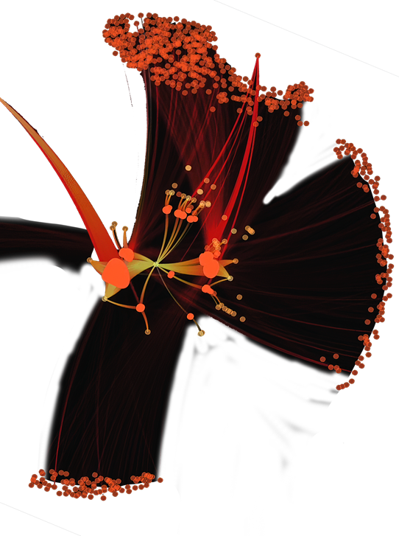
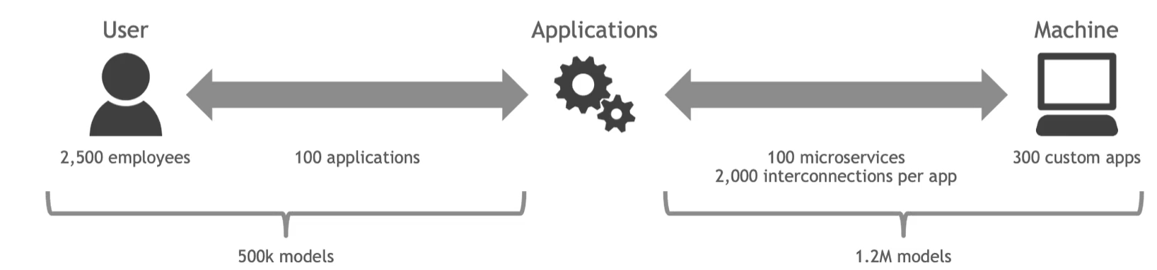






Digital fingerprinting
Anomaly detection at scale directly addresses DOD cybersecurity requirements
DIGITAL FINGERPRINTING
Create fine grained, unsupervised behavioral models for every user and machine
Find accounts and services meant for machines, being used by a human
Doesn’t require labelled data to get started
Anomaly Detection
Machine
Human
Machine
Machine
Machine
…and Sensitive Information Detection, Phishing Detection, Network Mapping, Predictive Maintenance, DGA algorithm detection…
Human
Machine
Notes:
AWS CloudTrail logs

Slide 32
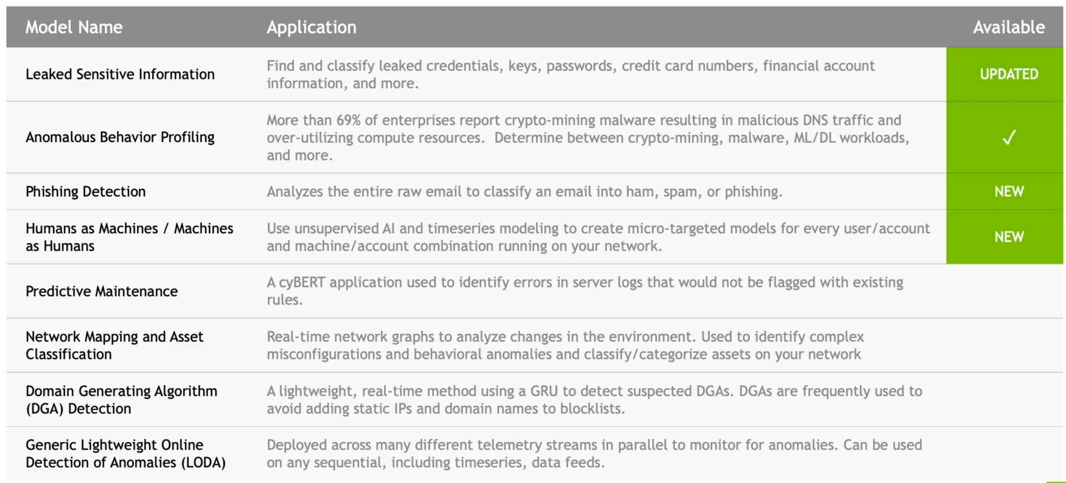
Pre-built Models and Use Cases
Bootstrap development with pre-built examples and pre-trained AI models

Slide 33
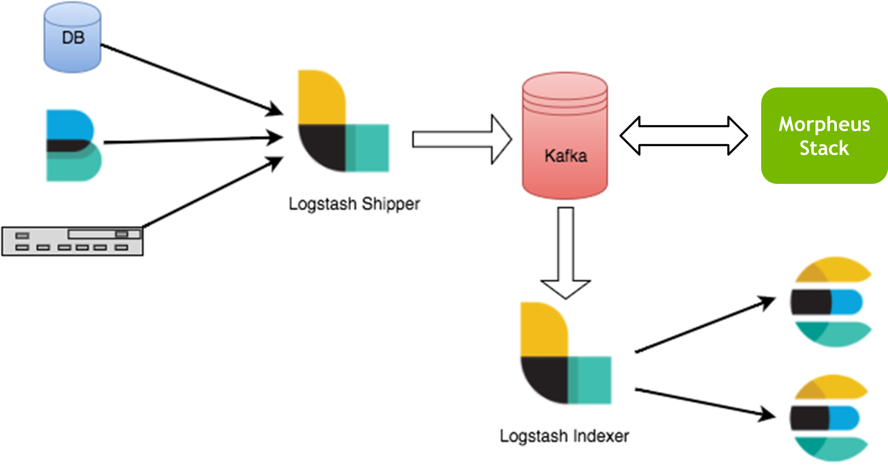

Notional ELK stack Integration
2) Leverage Kafka as a fault tolerant transport layer
**
1) Raw logs and sensor readings are generated by an arbitrary set of nodes on the network
3) Execute high throughput data processing and AI inference pipelines
**
*
**
Integrating Morpheus with the ELK stack makes deploying AI on high velocity cyber data streams tractable
5) Data visualization
4) Indexed data has enhanced with additional context to support downstream applications (e.g. analytics, remediation, etc.)
*Some workflows go straight to Kafka and skip this step (e.g. Beats)
**Could run monitoring agents on the NVIDIA BlueField and offload the host (DOCA telemetry or Beats)
Inspired by: https://www.elastic.co/blog/just-enough-kafka-for-the-elastic-stack-part1
https://faun.pub/kafka-with-elk-stack-deployment-the-logging-nightmare-relieved-part-1-d99ba4bd8166

Slide 34
Partners & developer community

Slide 35
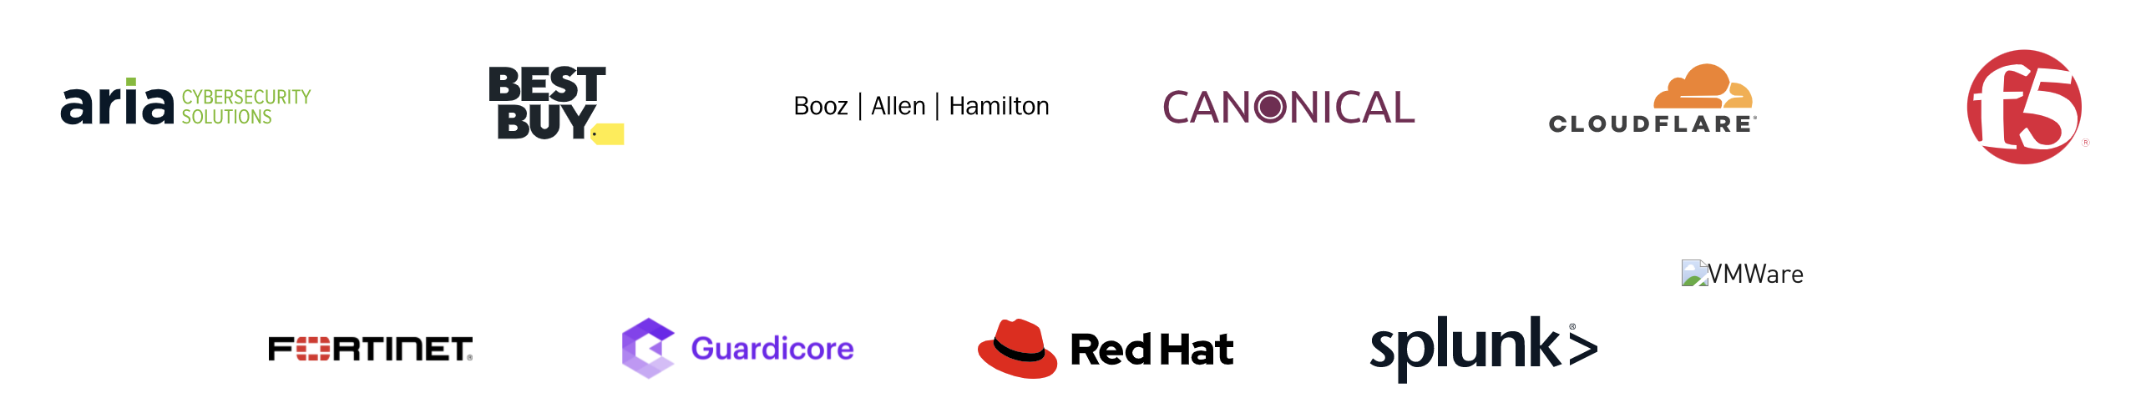

RESEARCH PARTNERS AND DEVELOPER COMMUNITY
Notes:
Our community of development and research partners is growing. We’re excited to be working with some of the largest names in cybersecurity, retail, and integration to make the next wave of innovation a reality. You gotta check out the talks by our partners at this GTC. Don’t miss ones by Splunk, HPE, F5, Booz Allen Hamilton, and many more in the cybersecurity track. I think you’ll be impressed with the difficult challenges being tackled and solved.

Slide 36
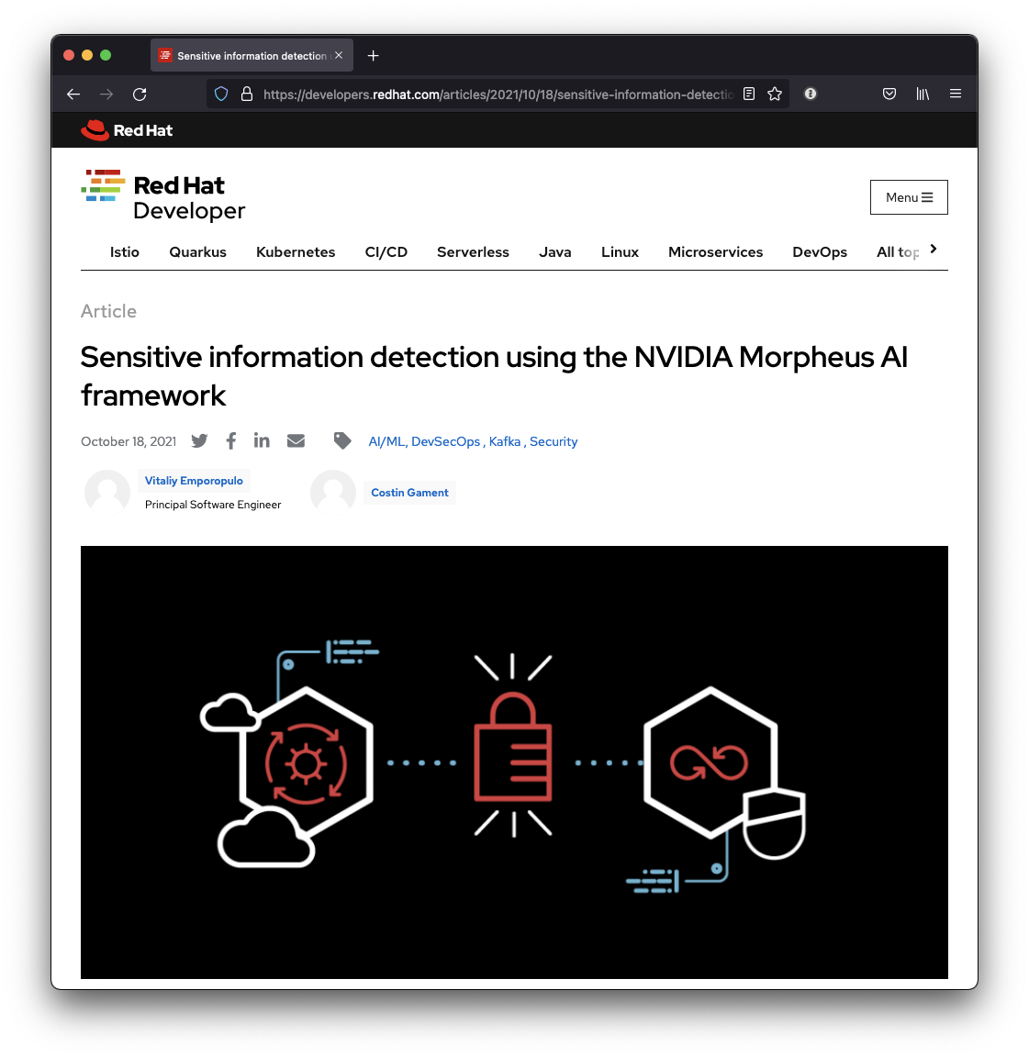
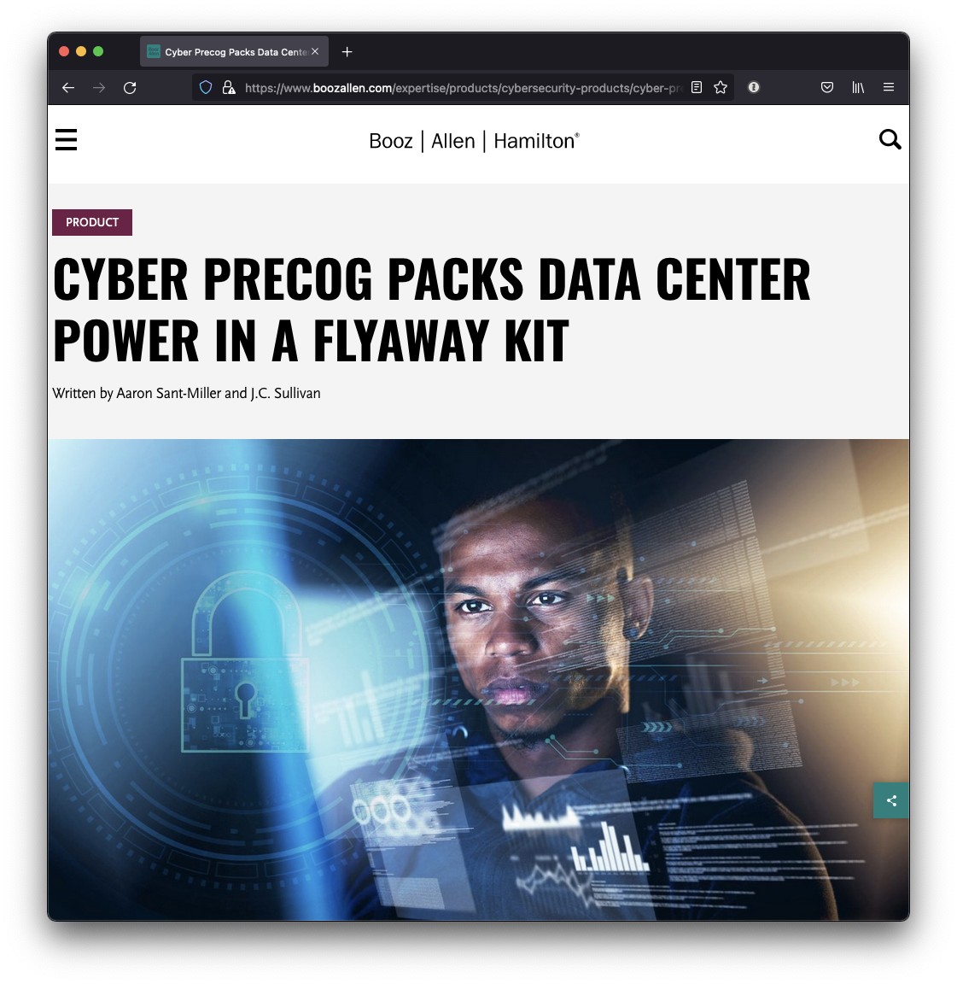
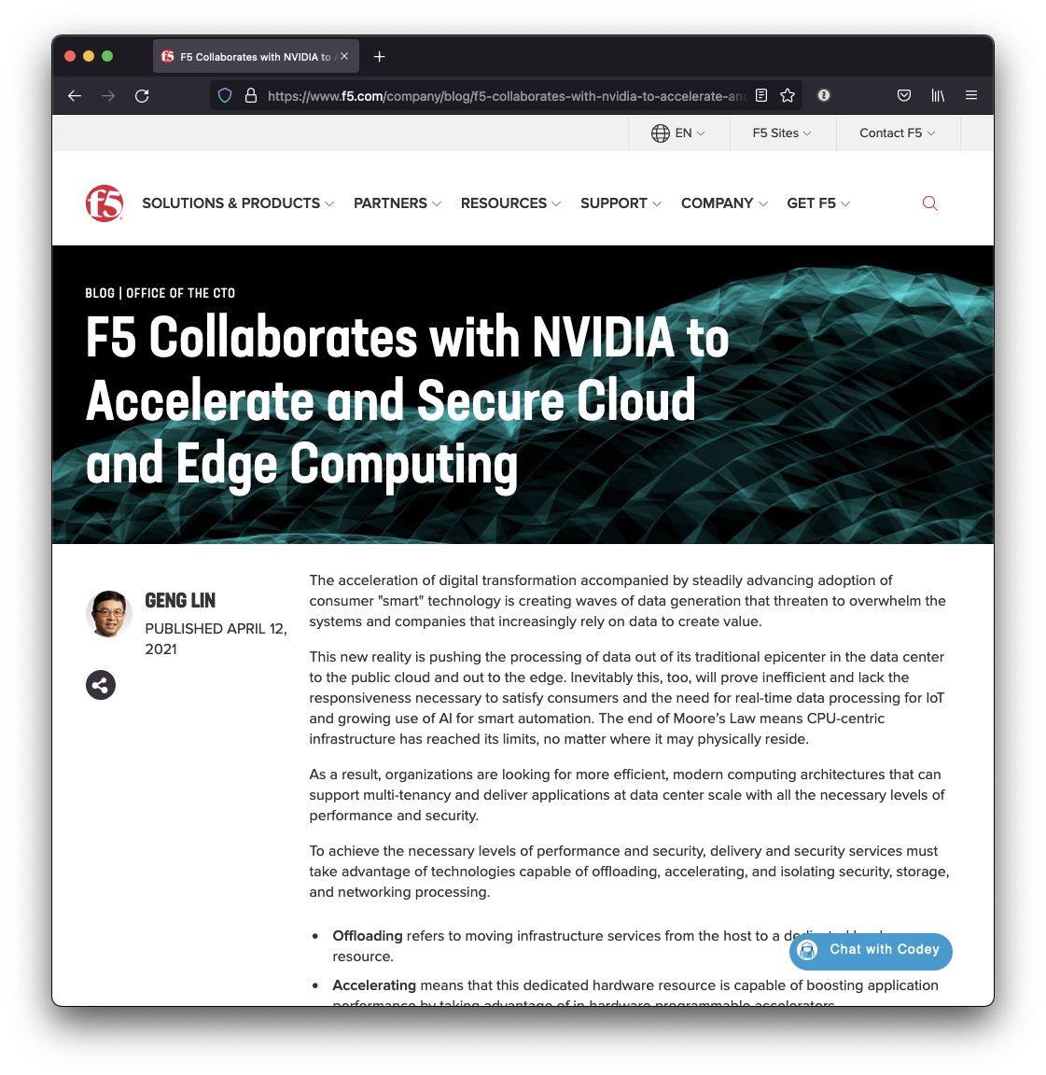
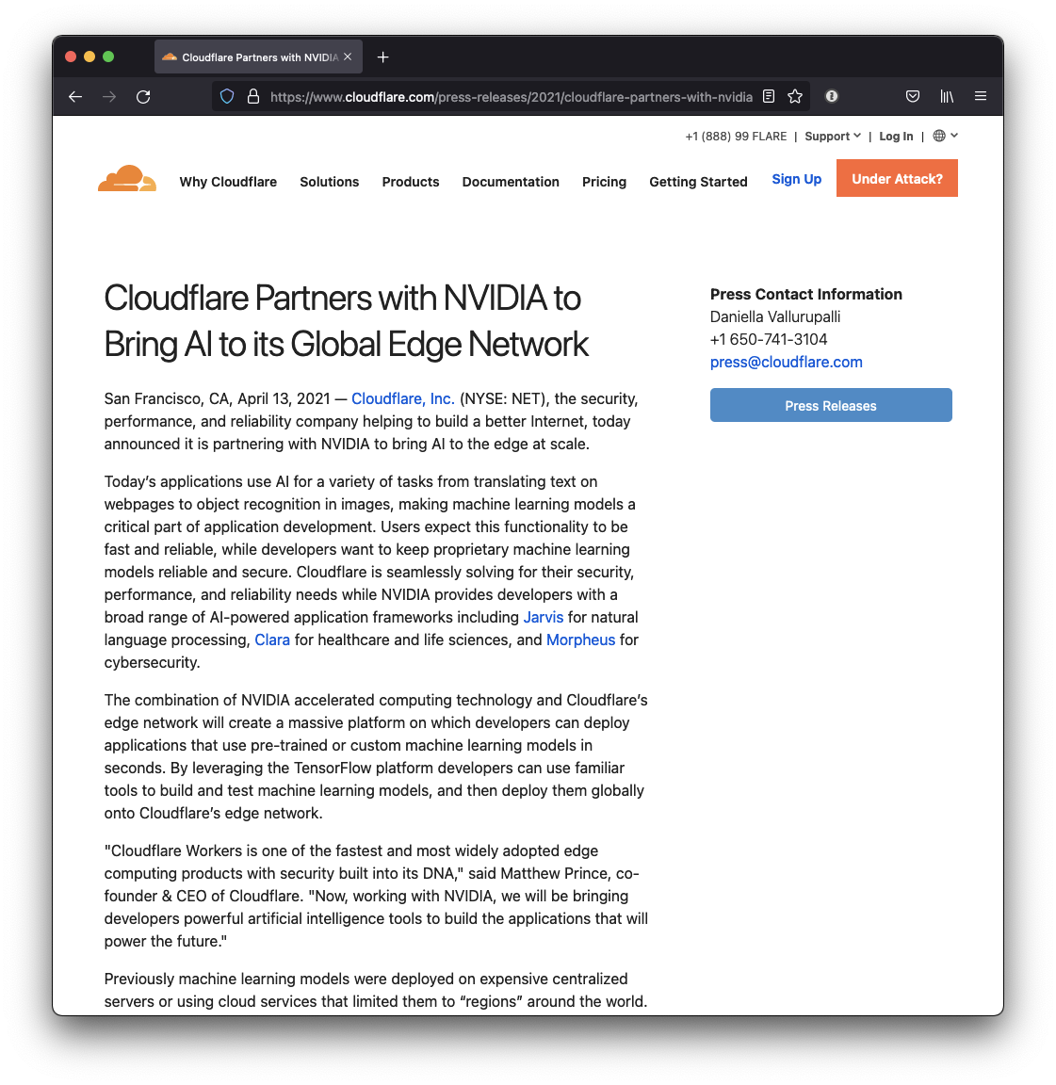
Notes:
Our partners have written some outstanding blogs about how they’re using Morpheus or how it integrates and helps their existing tools. Red Hat’s develop blog helps OpenShift users get started with Morpheus, while F5 is planning out how their collaboration with NVIDIA helps them secure computing at the edge and in the cloud. Indeed, edge computing is a theme – check out Cloudflare’s press release on edge computing at a global scale using NVIDIA technologies. And Booz Allen Hamilton brings the power of edge computing to you, with their next generation flyway kits – powered by Cyber Precog running on Morpheus.

Slide 37
Morpheus + Splunk at the edge

Slide 38




Morpheus + Splunk universal forwarder at the edge
PERCEIVE
INFER
ACT
GENERIC FEEDS
DATA PREP
INFERENCE
POST PROCESS
VERIFY
FEEDBACK
PCAP
NVSMI
Email
NVIDIA MORPHEUS + MONITORING
SPLUNK ENTERPRISE TOOLS
Kafka
RAPIDS/CLX
Splunk Universal Forwarder
Prometheus
Splunk Enterprise Security
Splunk Phantom
TRITON
TensorRT
Grafana
Splunk Data Streaming Processor
EGX STACK

Slide 39
Deep log parsing with cybert

Slide 40
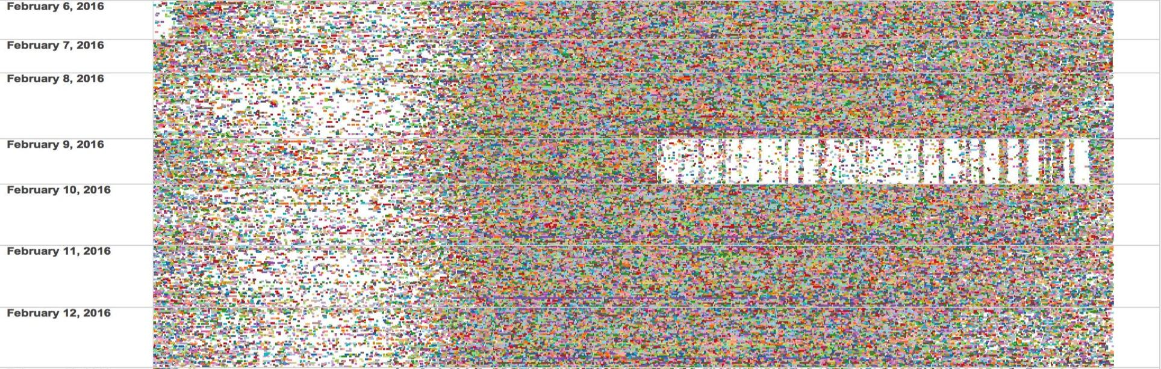
PARSING LOGS TAKES TOO MUCH TIME
Parsing Logs In Real-Time Often Results in Missed Data
Missing logs due to degraded logs or overwhelmed sensor attempting to parse logs
Results in lost data
What happens when secops needs to investigate an incident and the data isn’t there?

Slide 41


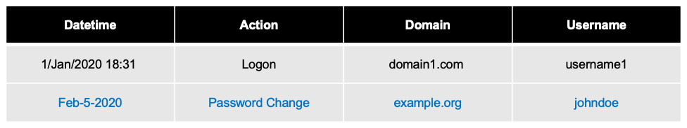
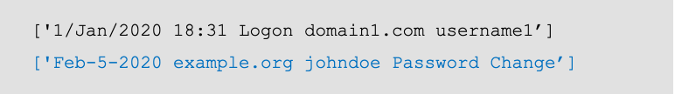

deep Log Parsing
Log parsing is central to every SecOps activity
Industry standard methods are insufficient, do not scale, and frequently result in missing or dropped data
Log types and formats are constantly changing, and new types are being introduced by both manufacturers and into corporate SIEM environments
Designing log parsing mechanisms is a human-dependent task, well-suited for acceleration with machine and deep learning methods
Corrupted logs often cannot be parsed and result in loss of data
A flexible, AI enabled cyber log ingest capability can speed up cyber hunt/triage operations and allow security operations to better allocate their human resources

Slide 42
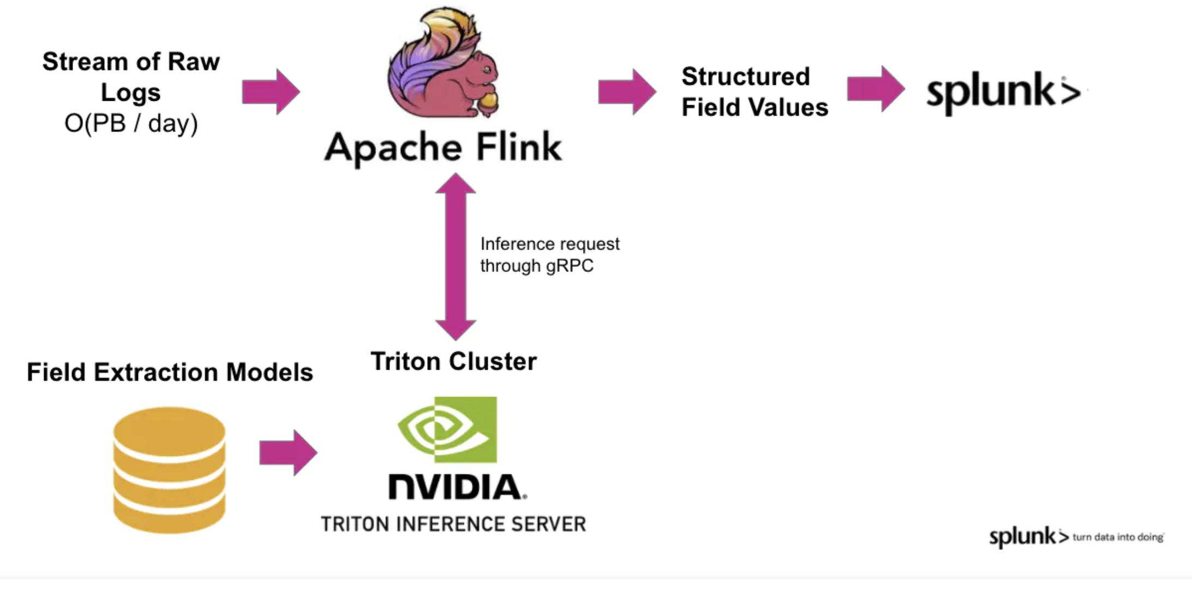
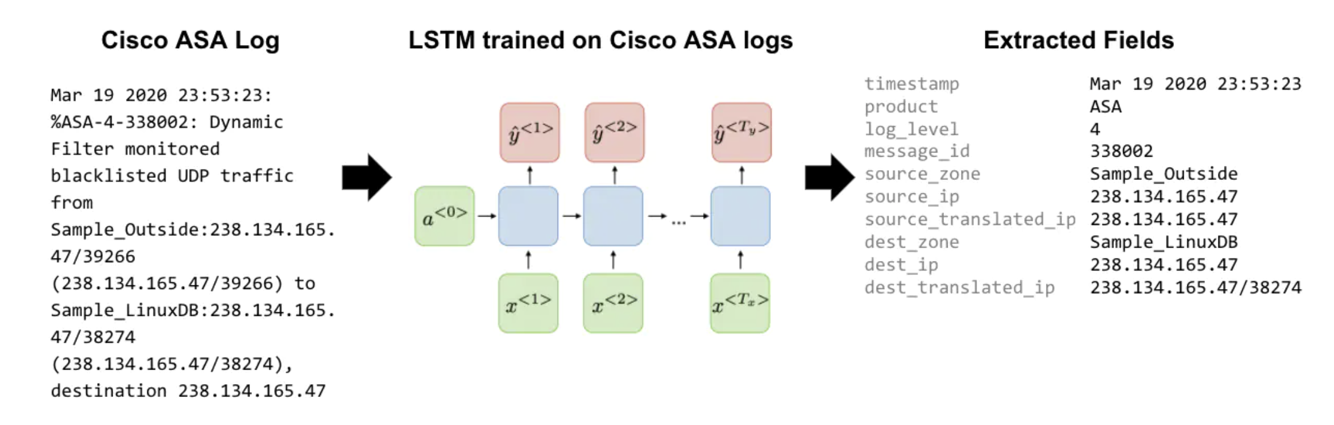
Integrating Morpheus with Splunk DSP

Slide 43
Cyber Fly-away kits

Slide 44
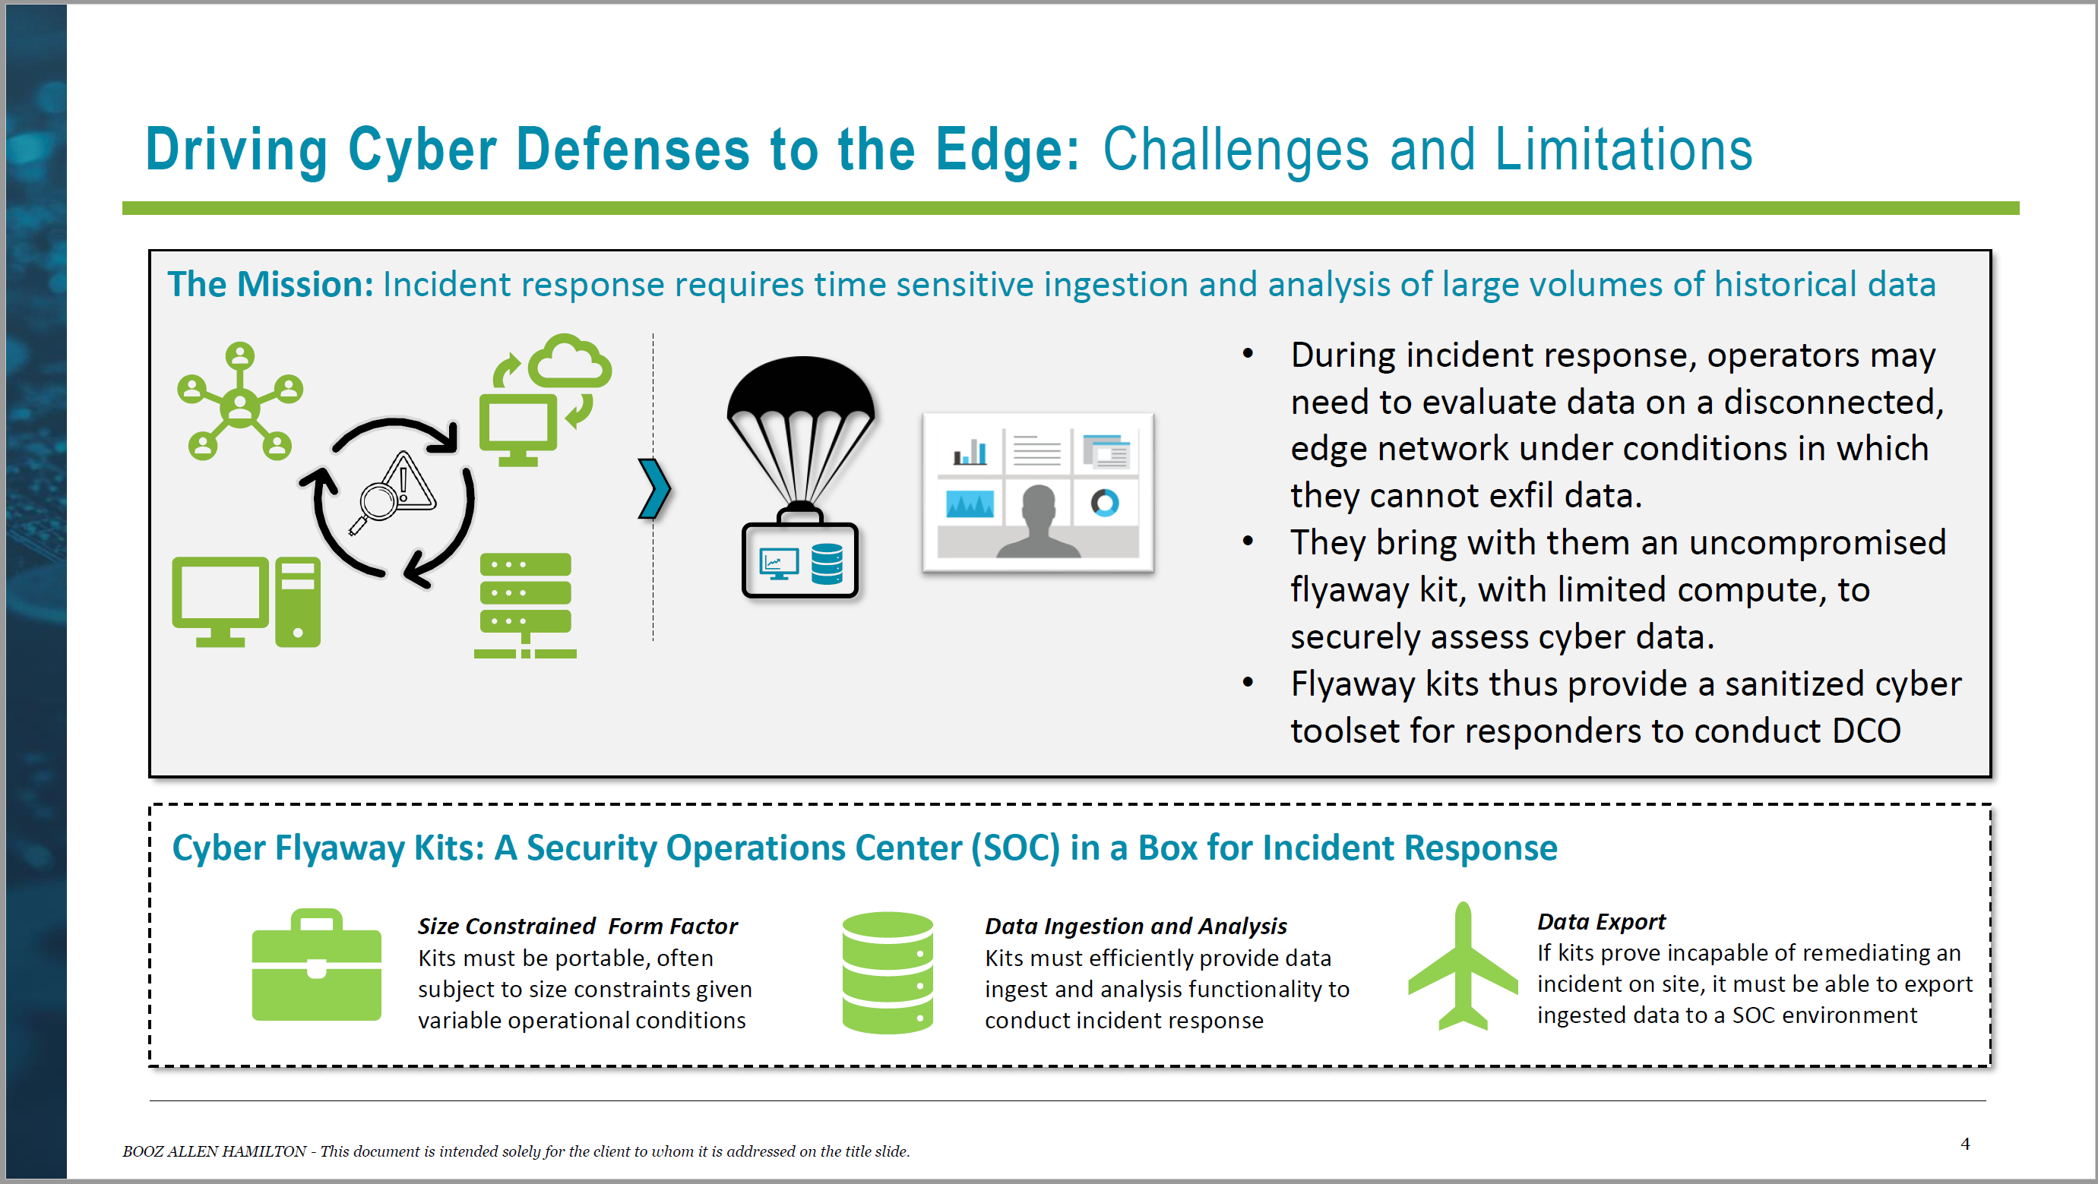

Slide 45
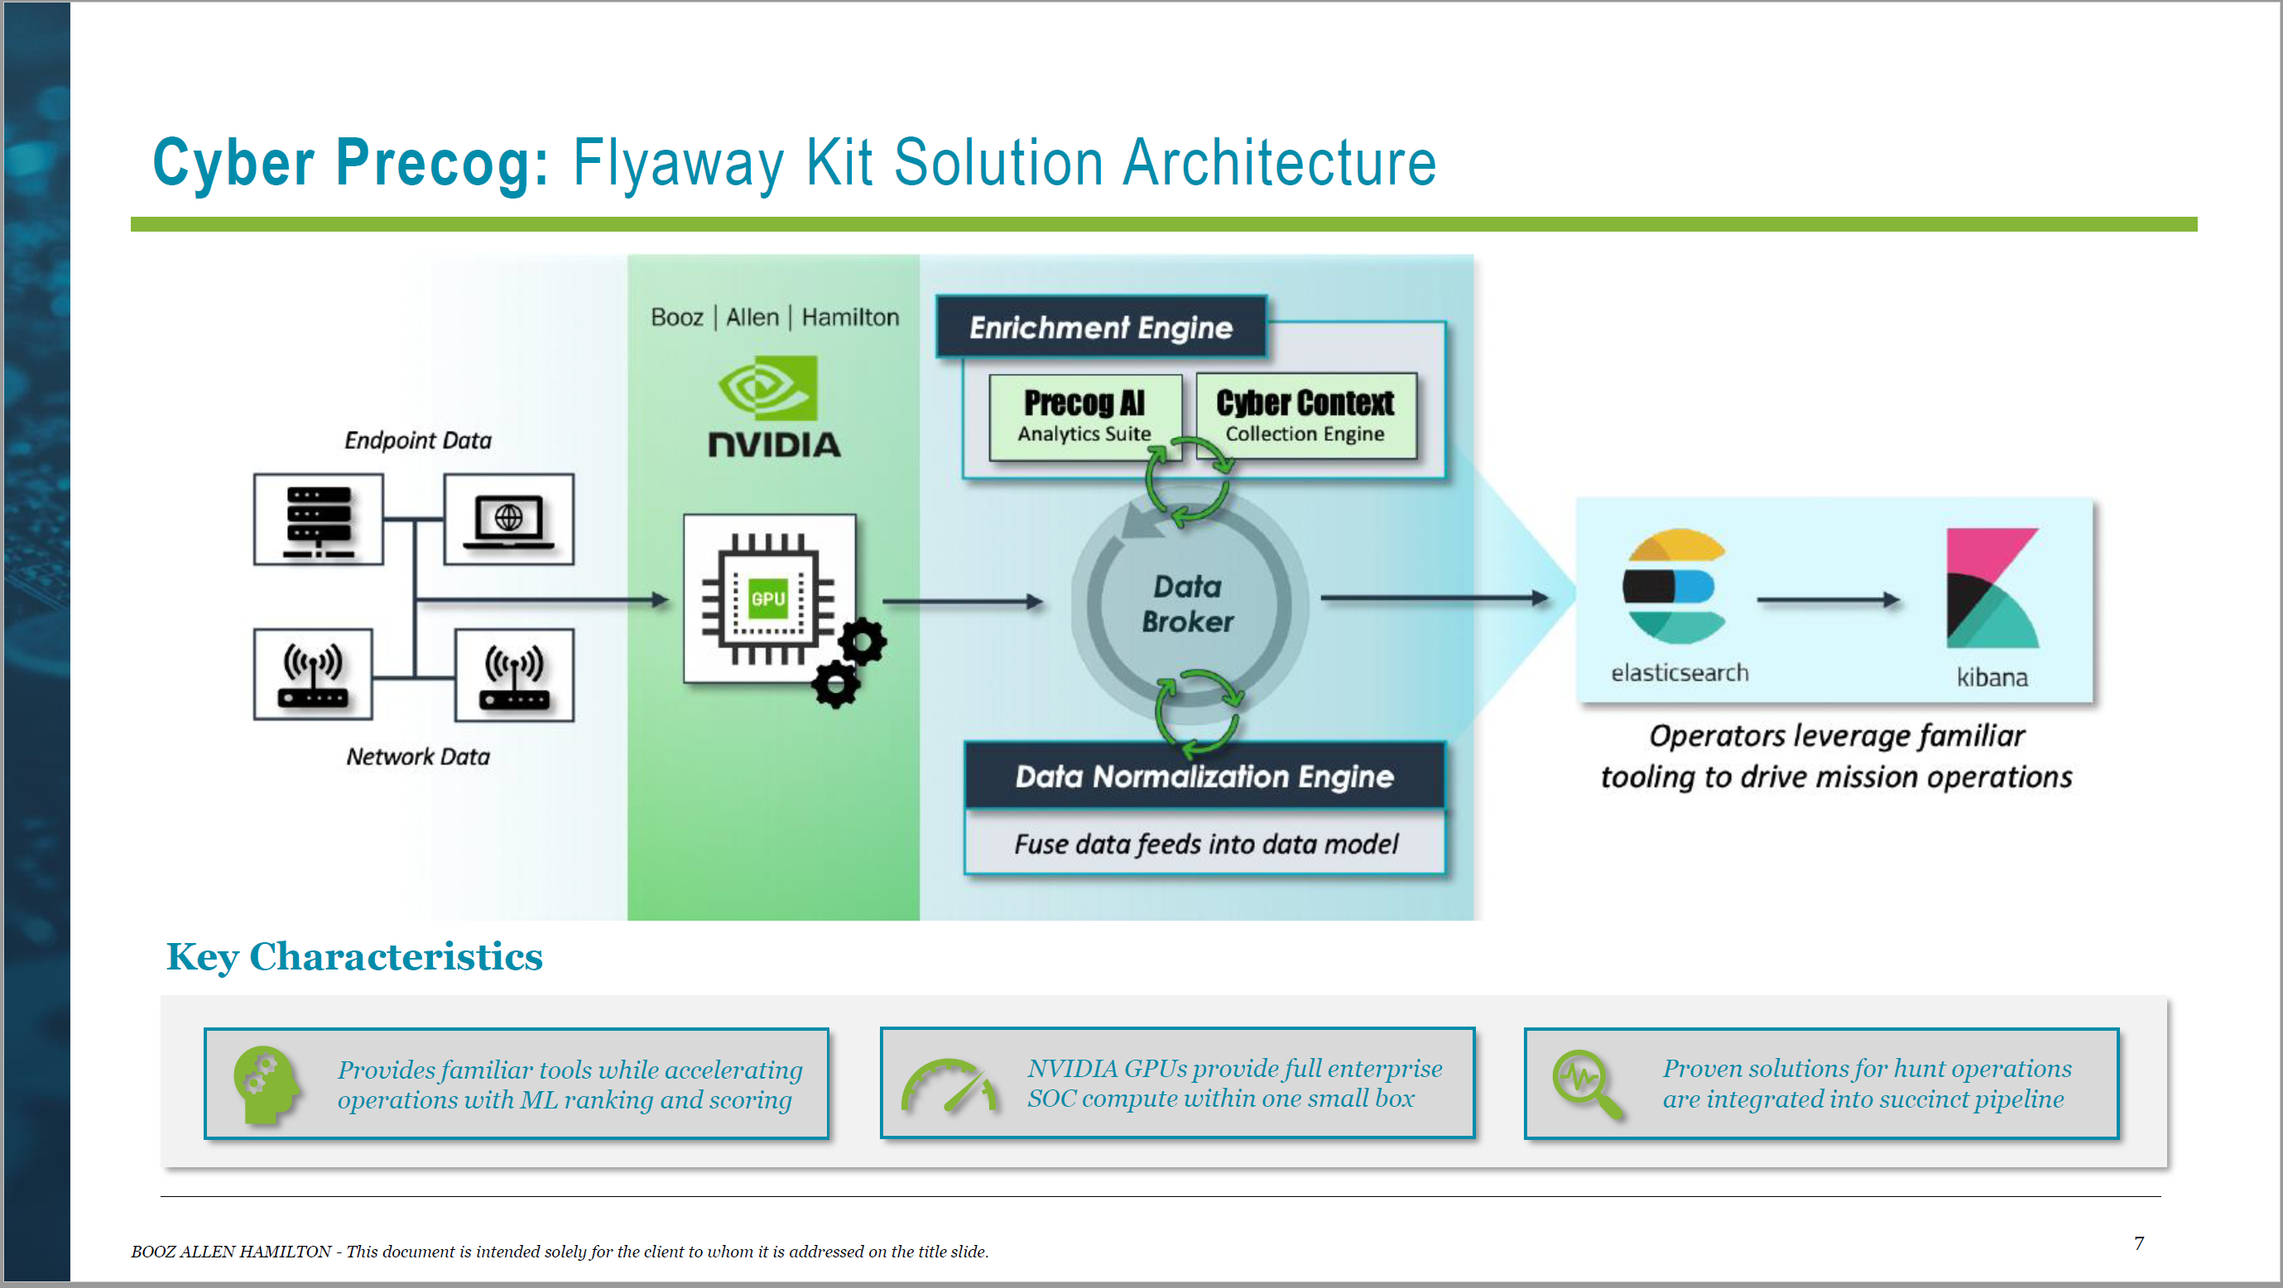

Slide 46
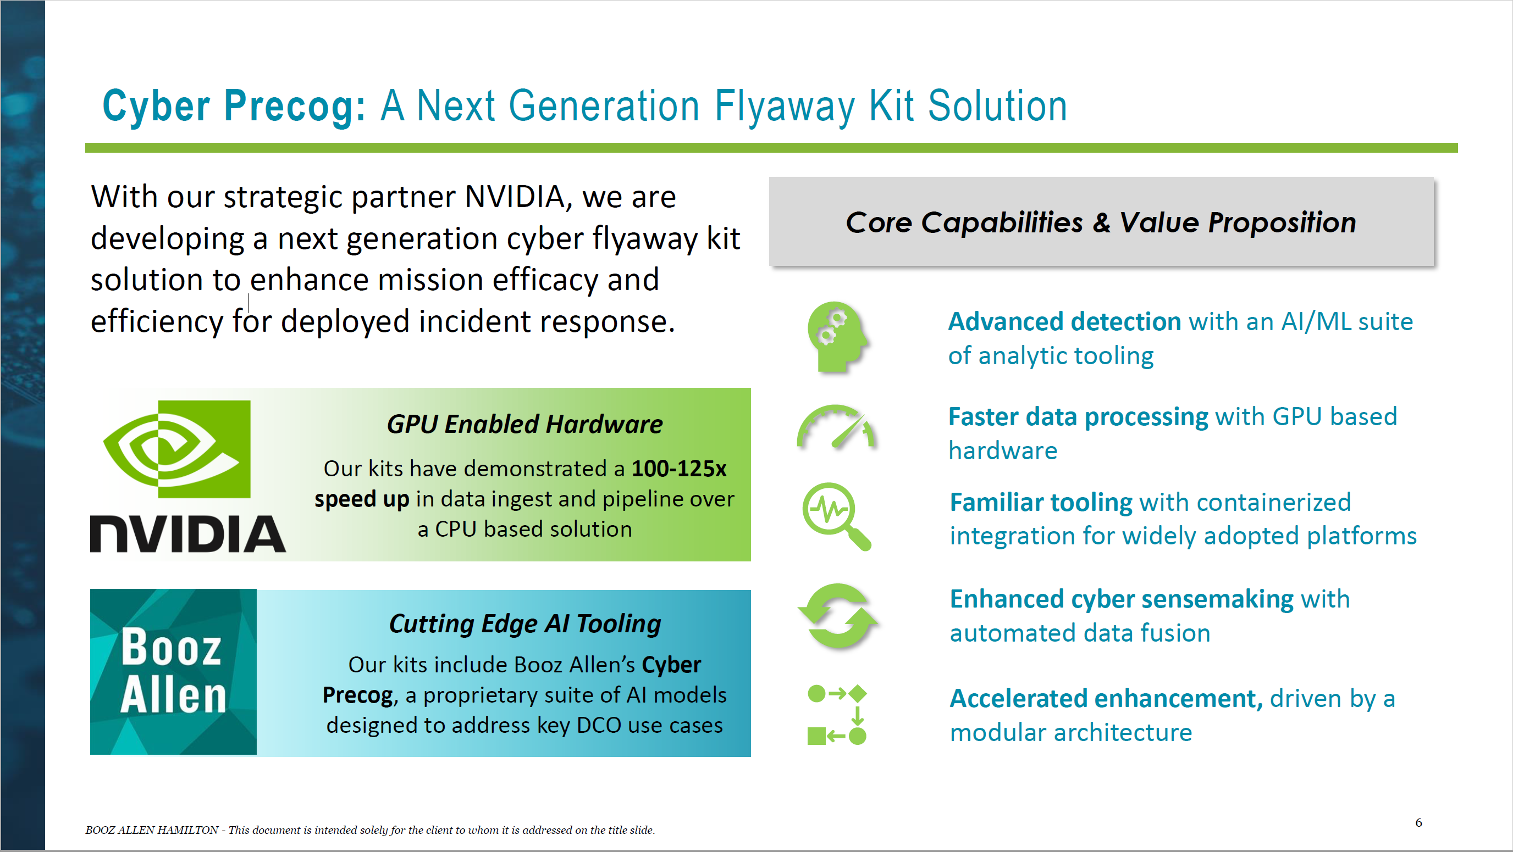

Slide 47
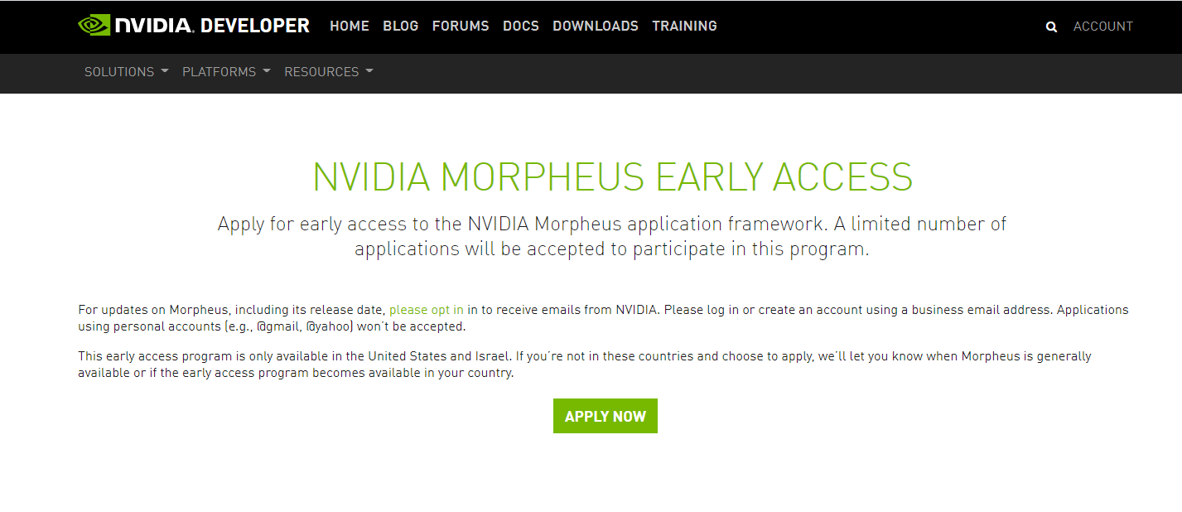
Apply for early access today!
https://developer.nvidia.com/morpheus-early-access

Slide 48
Bringing it all together
Providing the raw materials for tomorrow’s defensive cybersecurity
NVIDIA Provides…
Processors that apps in the data center run on
Smart Network Interface Cards (NICs) + Switches that control the data flow + support infrastructure provisioning
Frameworks + Software Development Kits (SDKs) to integrate high performance data monitoring and near real-time security intervention + post hoc data exploration
The building blocks to build next generation cyber defense capabilities

Slide 49
Helpful Resources
Triton
Morpheus Blog
Morpheus EA
Confluent Kafka
Apache Zookeeper
CLX Webinar
10 Minutes to CLX
BERT Paper
RAPIDS
CuPy
CLX Jupyter Notebooks
CLX Github
Splunk Log Parse Blog
cyBERT Blog
Subword Tokenizer Blog
CLX Blog
NVIDIA GPU Cloud (NGC)
Triton Container
Pre-trained models
Triton Github
RAPIDS Github

